Slide 1
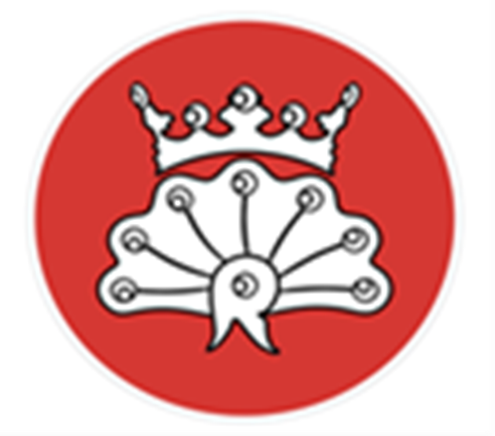
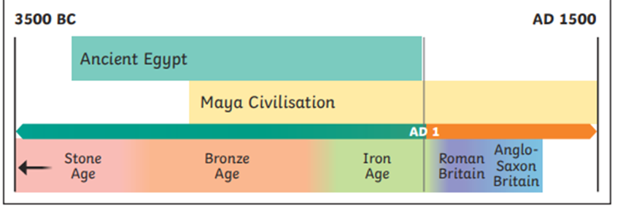
Year 5/6 Summer 6
Who were the Mayans?
 | Skills & Knowledge
1 | When was the Mayan civilisation and what else was happening in the world during that time?
2 | How diverse was the Mayan society?
3 | What could you use to find out about the Mayans and why is it important to use a range of sources and evidence?
4 | What continuity and change occurred during this era?
5 | What do you need to do to produce a good product?
Key Vocabulary
civilisation | An organised society with its own culture and way of life, existing in a particular area over a particular period of time.
ritual | A ceremony, often religious, with set actions performed in a set order.
codices | Ancient handwritten texts. Maya codices could be unfolded like a concertina. One text is called a codex.
drought | A long period with very little rain.
maize | Another word for sweetcorn or corn on the cob. It can be made into a dough and baked into tortillas.
jaguar | A big cat, heavier than a leopard, with yellowish fur and black spots.
scribes | People trained to write things down, either as an official record or for someone else unable to write.
cacao beans | Cacao trees sprout pods directly from their trunks. When they are ripe, the pods can be broken open to reveal the beans, which can then be dried, roasted and ground.
glyphs. | The Maya writing system was used to write several different Maya languages. It was made up of many symbols called glyphs. Logograms are glyphs representing whole words. Syllabograms are glyphs representing units of sound (syllables).
The Afterlife | The Middle world – The Maya people believed that the Earth, which they called the Middle world, was large and flat and resting on the back of a creature, such as a turtle or crocodile. The Upper world – The Maya believed this was in the sky or heavens and was connected to the Middle world by the branches of a tree. The Underworld – A tree connecting its branches to the Upper world was also believed to grow its roots down to the Underworld.
Interesting Facts
The Maya made a bitter chocolatey drink from cacao beans that was enjoyed by the rich and used for medicines and in ceremonies. The beans were highly valued and even used as a form of money.
The Maya developed a complex number and counting system that was advanced for their time. They were one of only two cultures in the world to develop the concept of zero.

