Slide 1


Slide 2

Our F.O.R exists to:
Support the school and enhance pupil’s experiences
Bring parents, carers, staff and the community
together
Raise funds responsibly for agreed school priorities

Slide 3

F.O.R. membership:
Open to all parents, carers and staff of the school
Members to attend 3 old term meetings, volunteer and stand for committee roles
All members share responsibility for supporting the F.O.R’s aims

Slide 4
F.O.R Committee Roles:
Chair
Vice Chair
Secretary
Treasurer
Vice Treasurer
Why this structure?
Shared responsibility
Continuity and resilience
Support for volunteers

Slide 5
How we Operate:
Regular committee and general meetings
Annual elections for officer roles
Decisions made collectively and recorded
Major spending agreed in advance

Slide 6
How We Manage F.O.R Finances:
Dual signatories on all bank accounts
Committee approval for significant expenditure
Regular financial reporting to ensure transparency
Review of outcomes to inform future planning

Slide 7
Looking Ahead:
Clear roles and shared responsibility -
Ensuring responsibilities are understood and fairly distributed
Strong financial oversight -
Protecting funds and volunteers through transparent processes
Sustainable event planning -
Balancing enjoyment, affordability and fianacial outcomes
Succession planning -
Making it easier for new volunteers to step into roles over
time

Slide 8
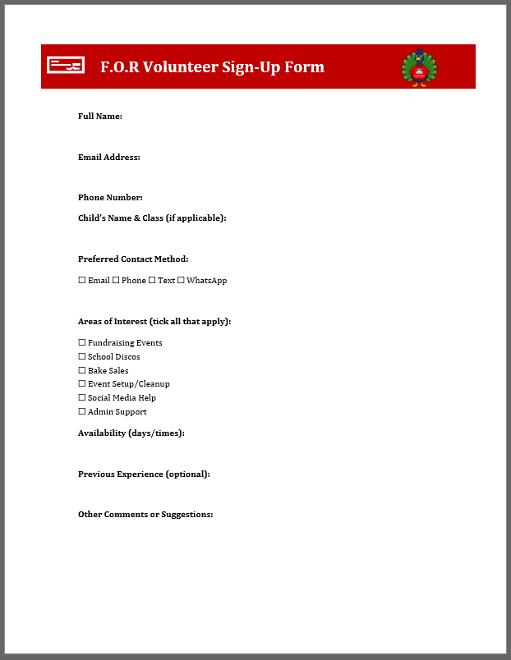
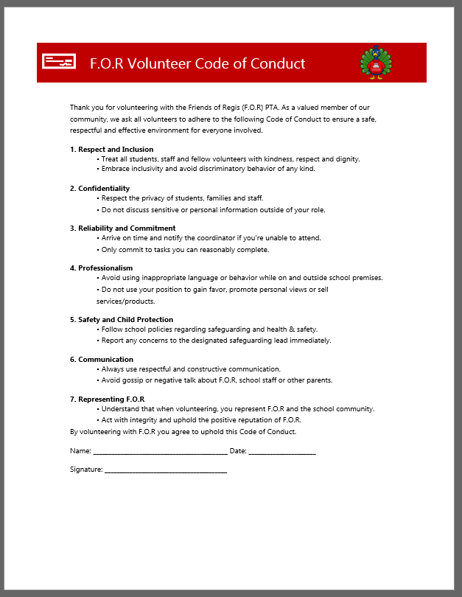

Slide 9
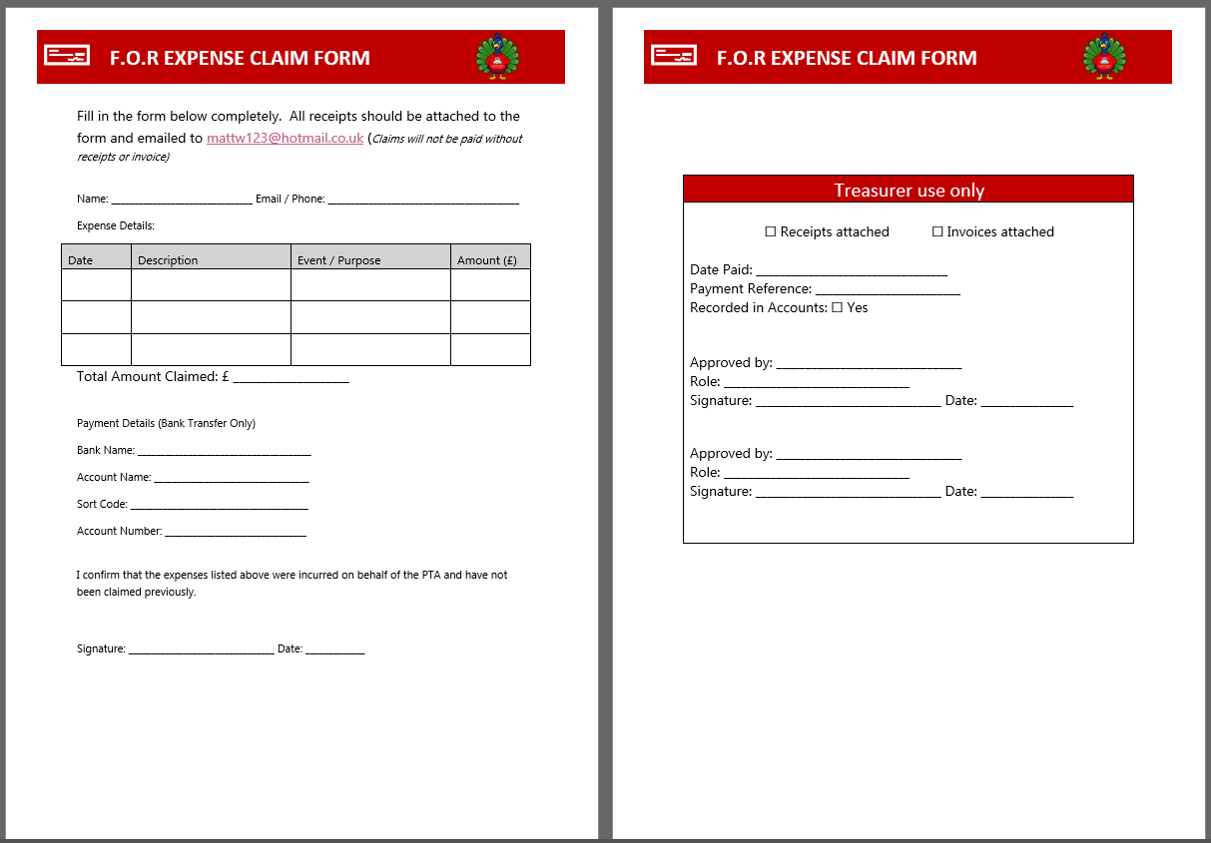

Slide 10
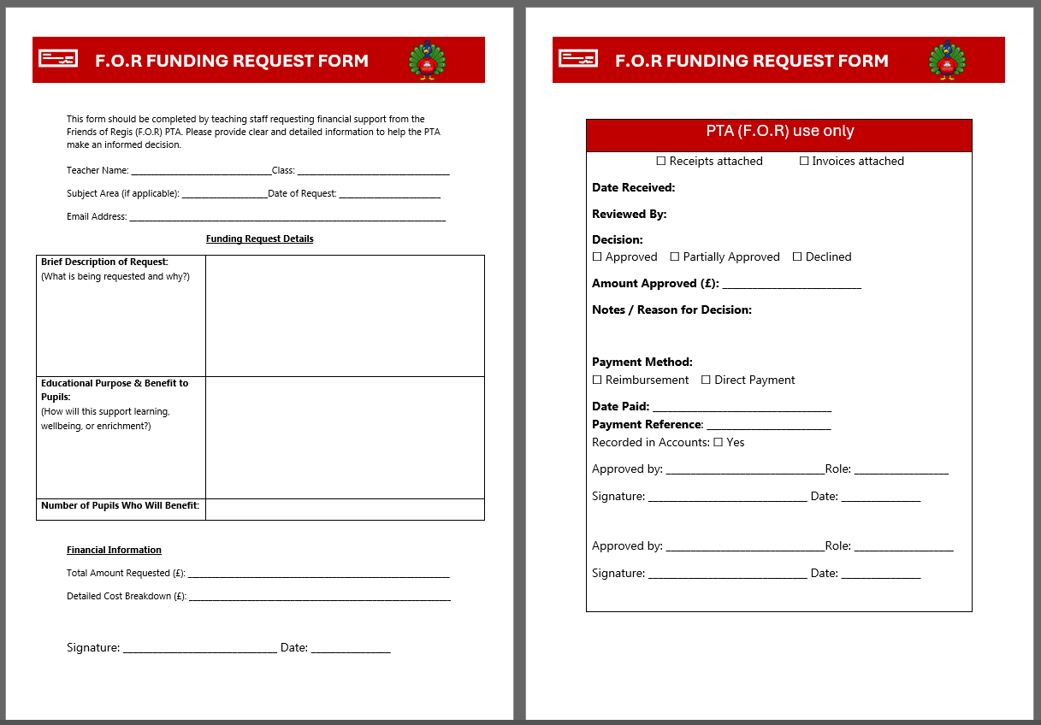

Slide 11
A PTA Constitution is basically the rulebook or governing document for a Parent-Teacher Association (PTA). It outlines how the PTA is organised, how it operates, and the rights and responsibilities of its members. Think of it as the foundation that keeps the PTA running smoothly and legally.

Slide 12
It clearly identifies the PTA (name and purpose).​
It defines membership (who can join).​
It sets up leadership/management (Executive Committee and roles).​
It outlines meetings, elections, and decision-making.​
It deals with finances and funds responsibly.​
It allows for amendments and dissolution​

Slide 13
Thank You!

