Slide 1
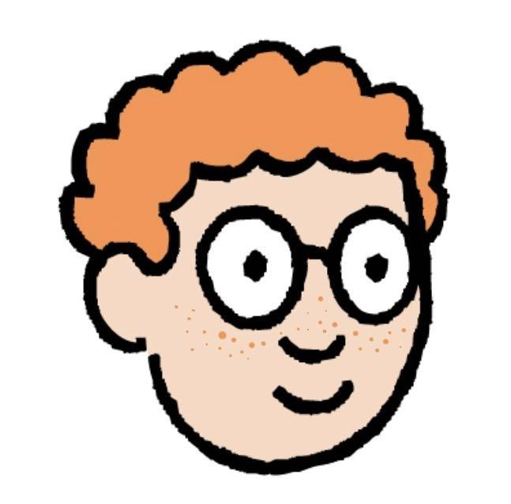
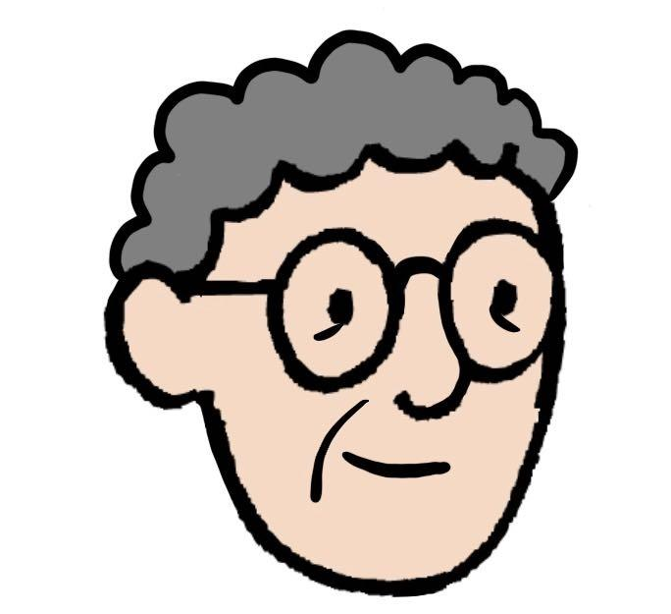
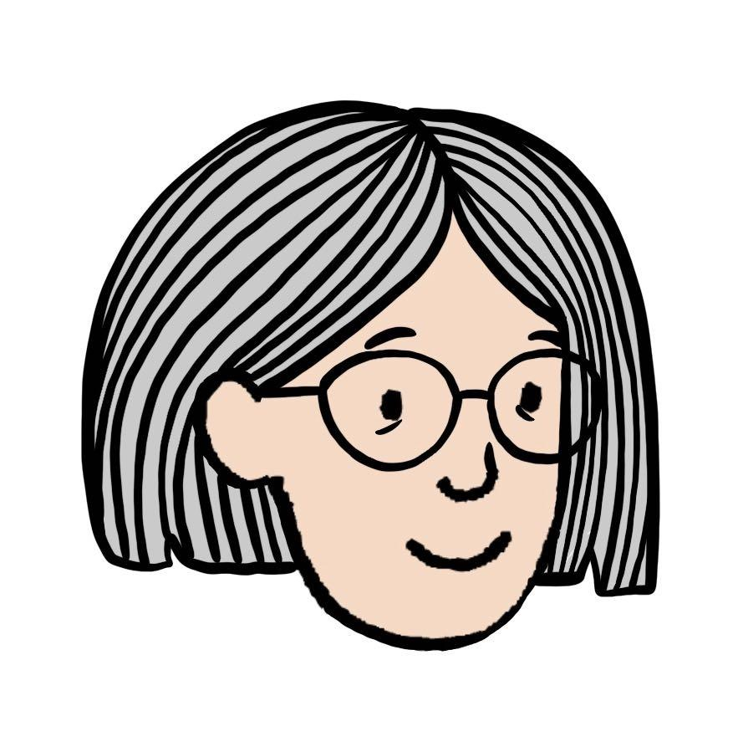
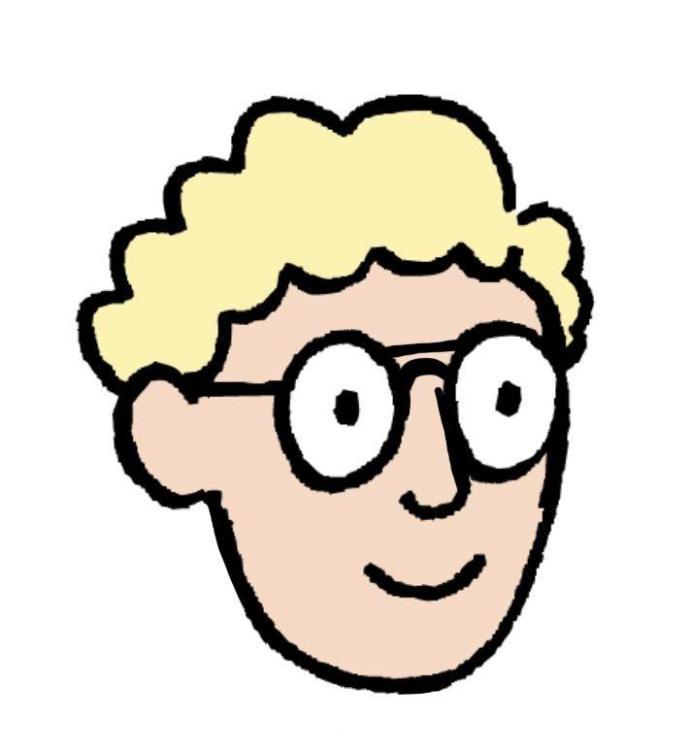
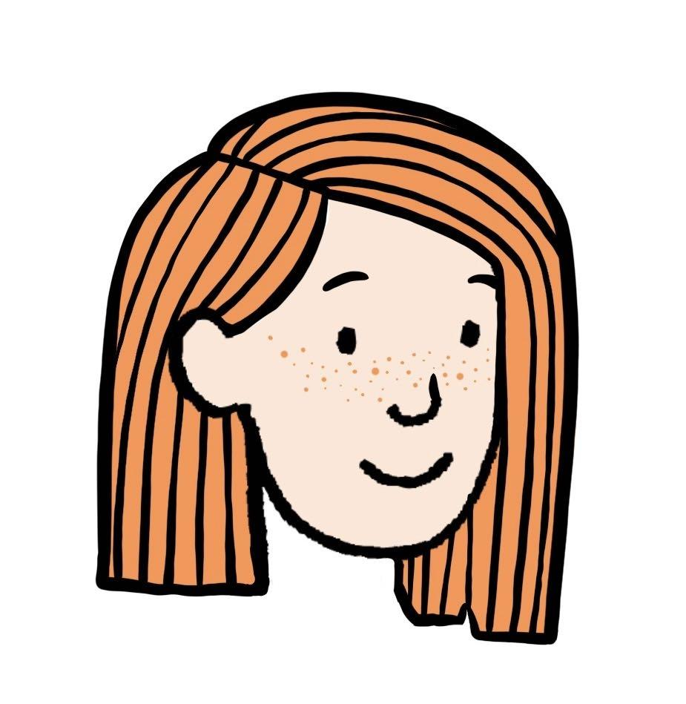
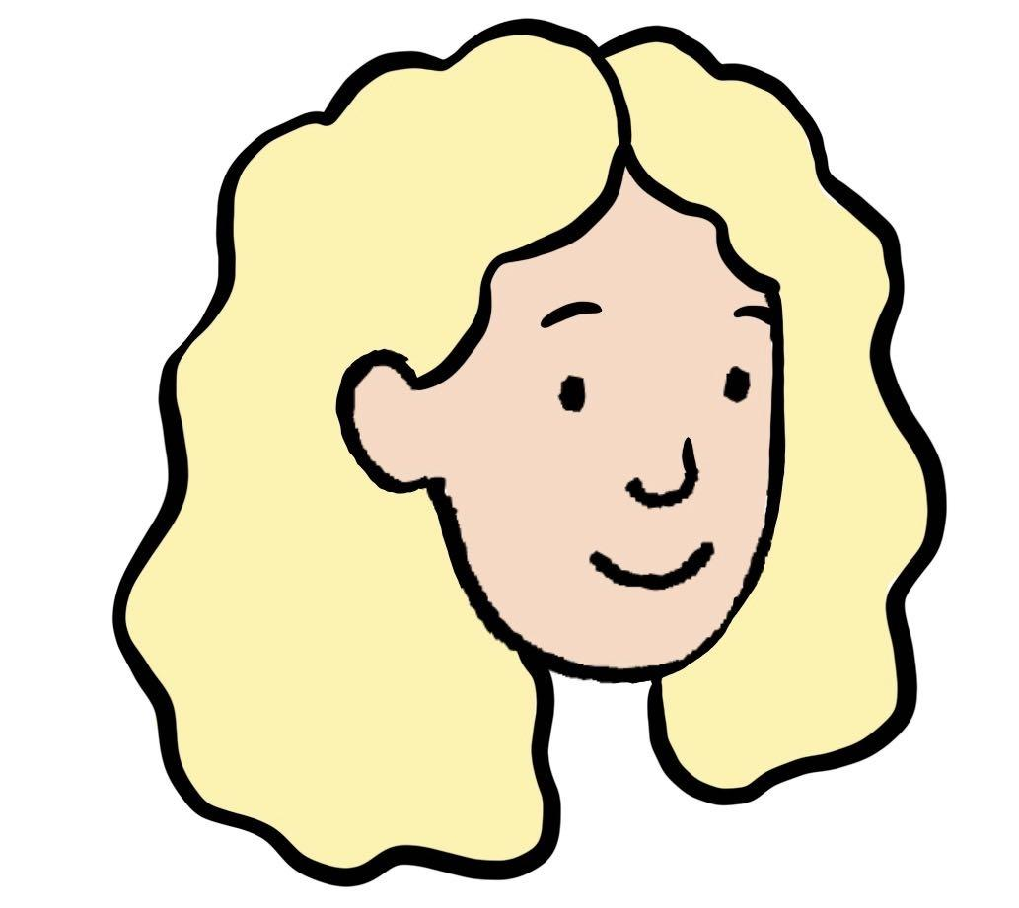
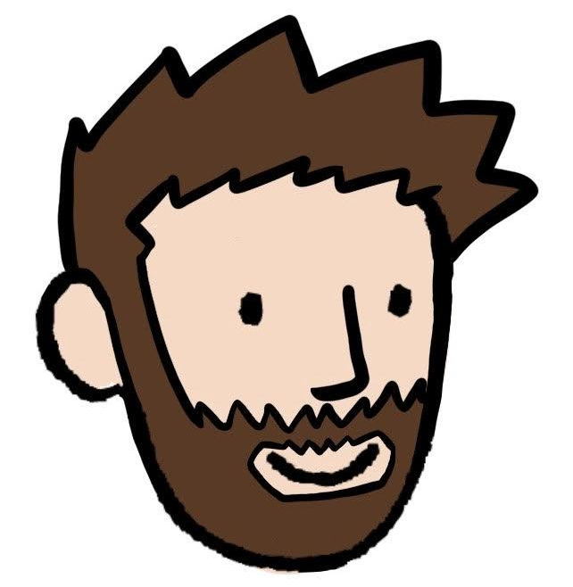
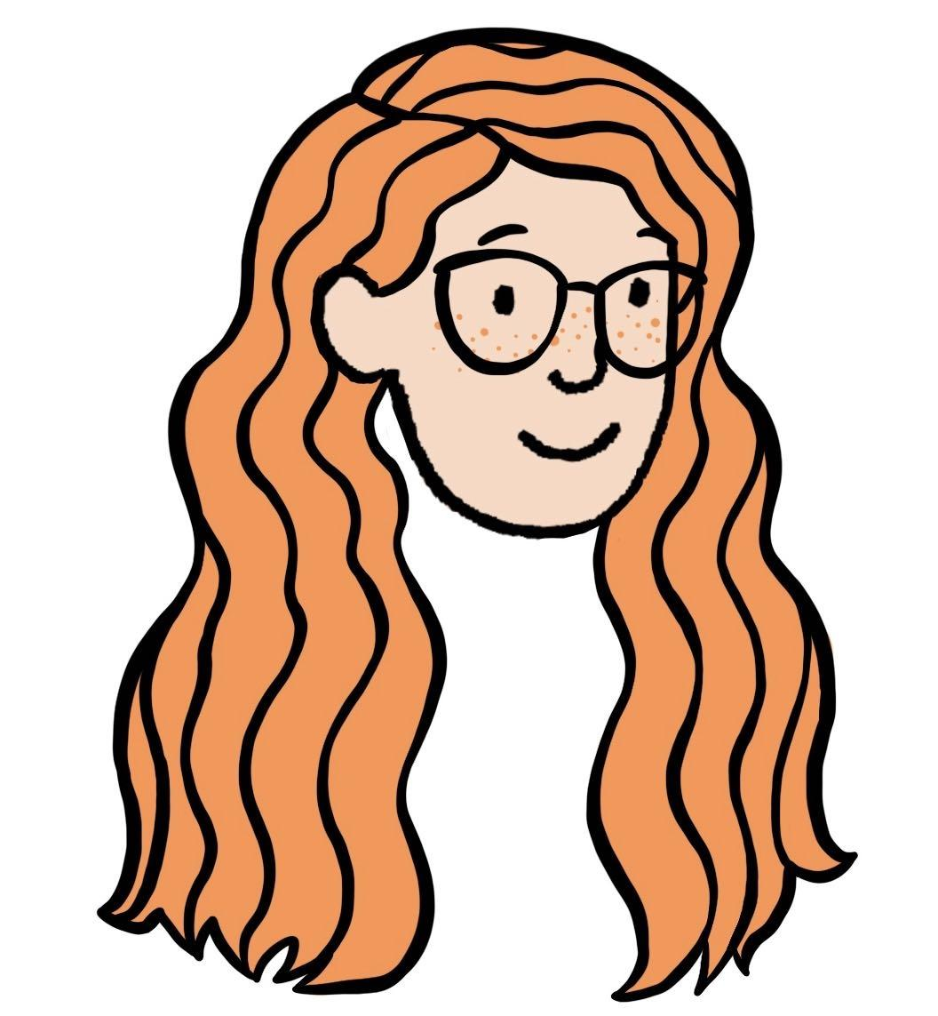
Family trees
Task A: Family trees
Draw a family tree showing three generations of a family.
You should include the name of each person and a drawing of their face.
You can draw your own family tree or use Alex’s family.
This is my family.
Alex
Andy
Laura
Alfie
Sarah
These are my grandparents. They had two children, Andy and Susie.
Andy is my dad. He’s married to my mum, Laura.
Susie
Mike
Tim
Susie is my aunt. Her spouse is called Mike. They have a baby together called Tim.
Jade
Sally
I have two sisters called Jade and Sally.

Slide 2
Family trees
Task B: Identifying similarities and differences
Choose two pairs of people with common ancestors from your family tree or Alex’s and describe the similarities and differences in the physical characteristics of each pair.
I’m going to compare myself with my dad, and then my sister with my aunt.
Alex
Centre for Industry Education Collaboration.
v2.3

