Slide 1
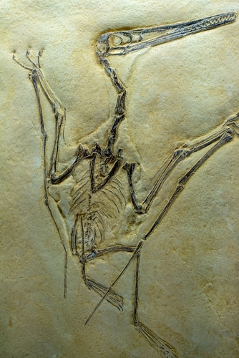
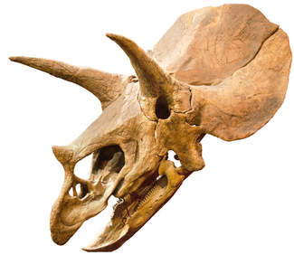
What fossils can tell us about the past
Task B: Palaeontology
Observe the photographs of fossils and read the paleontologist’s notes carefully.
Use all the evidence you can see to write a report about what the living thing may have been like.
You could try and deduce:
What type of animal was it?
How big was it?
Was it a predator or prey?
What did it eat?
How did it move?
fossil 1
Palaeontologist’s notes:
Very thin, delicate bones.
Length from head to tip of tailbone = 25 cm
Travelershigh/Shutterstock.com
fossil 2
Palaeontologist’s notes:
Two longer horns each around 1 m long.
David Herraez Calzada/Shutterstock
v2.3

Slide 2
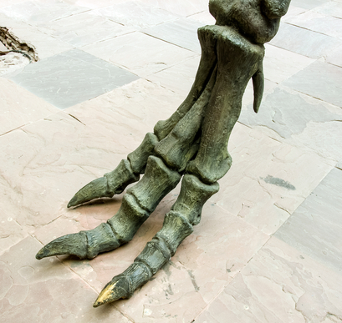
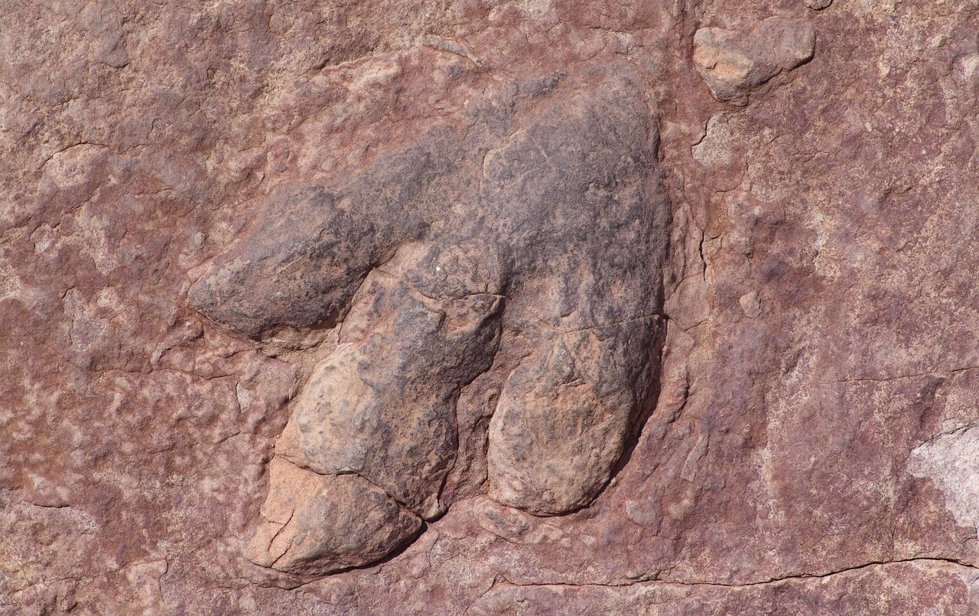
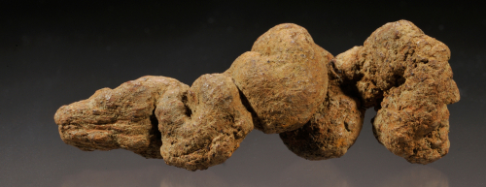
What fossils can tell us about the past
fossil 3
Palaeontologist’s notes:
9 footprints found near bones, each 46 cm long and around 4 m apart from each other.
phichet chaiyabin/Shutterstock
fossil 4
Breck P. Kent/Shutterstock
Palaeontologist’s notes:
Around 30 cm long.
Museum staff found traces of fish bones and scales embedded in coprolite.
Centre for Industry Education Collaboration.
v2.3

