Slide 1
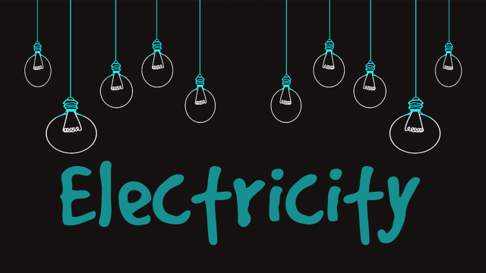
Year 6 Summer 5
What does electricity need to work?
 | Skills & Knowledge
1 | Can I use symbols to represent a simple circuit in a diagram?
2 | How can I construct a simple series electrical circuit that uses a switch, bulb and buzzer?
3 | Can I identify and explore the properties of good common conductors and insulators?
4 | Can I associate the brightness of a lamp or the volume of a buzzer with the number and voltage of cells used in a circuit?
5 | Can I compare and give reasons for variations on how components function?
Key Vocabulary
Terminal | Point of connection for closing an electric circuit.
battery | A container or one or more cells that is used to generate a current.bulb
Voltage | Force of an electrical current.
electrons | Very small particles that travel around an electric circuit and carry energy.
resistance | A measure of the difficulty of passing an electric current through a conductor. The more resistance in a circuit, the less electricity will flow through.
switch | A device used for making and breaking the connection in an electrical circuit.
static electricity | A stationary electric charge, typically produced by friction, which causes sparks, crackling or the attraction of dust.
filament | A conducting wire or thread with a high melting point which forms part of an electrical bulb.
Current | Flow of electrical charge.
Bulb | An electric bulb refers to an electric lamp which consists of a translucent or transparent glass housing.
Interesting Facts

