Slide 1
Subject Leader Impact Report
Religious education
2022-2023
Together Everyone Achieves More

Slide 2
Intent
How to communicate using appropriate vocabulary
At Corsham Regis we encourage children to listen and respond appropriately to adults and their peers. To ask relevant questions to extend their understanding and build vocabulary and knowledge using sentence stems to support them articulating and justifying answers, arguments and opinions.
We also encourage children to give well-structured descriptions and explanations whilst participating actively in collaborative conversations using spoken language to develop understanding. This is achieved through speculating, hypothesising, imagining and exploring ideas, as well as considering and evaluating different viewpoints, attending to and building on the contributions of others.
About Corsham and the local area
Where possible we reflect the religious backgrounds represented in the Corsham community. We attend our local church to learn about Christian festivals and celebrations including singing hymns and celebrating the children’s learning. Collective worship Assemblies and RE themed days provide various opportunities including: sharing of common values, the opportunity to learn about other religions through their festivals and celebrations. We encourage participation and response through active involvement in activities to develop a community spirit, promote a common ethos and shared values and reinforce positive attitudes.
Through experience inside and beyond the classroom.
As an academy we provide the opportunity for pupils to consider spiritual and moral issues and provide opportunities for them to explore their own beliefs. We promote wider reading such as stories from different cultures and non-fiction books to play scripts. This links to the writing the children do. Using the Discovery RE scheme of work, cross curricular links can be made with D&T, History, Art and Design, Geography and Music. From time to time, visitors will be invited to share their thoughts and beliefs.

Slide 3
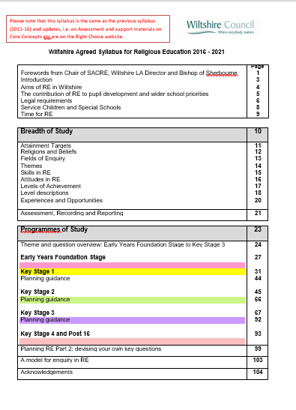
Implementation
At Corsham Regis, we follow the Wiltshire Agreed Syllabus for Religious Education.

Slide 4
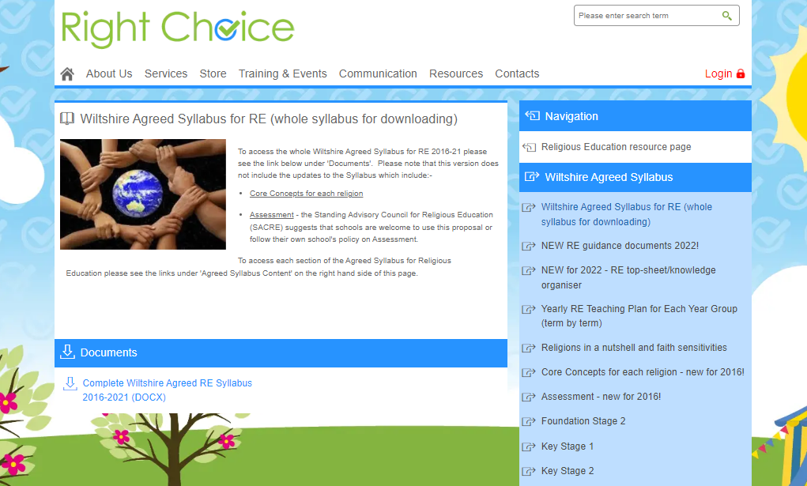
Planning, resources and other relevant documents/information is located on th Right Choice website.

Slide 5
The themes in this syllabus provide a way of opening up the Fields of Enquiry through exploring key questions. They differ across the key stages to reflect the progression expected as children and young people develop their understanding and skills. Whilst there is not a direct progression across all themes, this grid indicates the broad progression across key stages.
Foundation Stage Discovering | KS1 Exploring | KS2 Connecting
Special people | Believing | Beliefs and questions
 | Story | Teachings and authority
 | Leaders and teachers | Inspirational people
Special places | Symbols | Symbols and religious expression
Special times | Celebrations | Worship, pilgrimage and special places Journey of life and death
Being special | Myself | Religion and the individual
 | Belonging | Religion, family and community
 |  | Beliefs in action in the world

Slide 6
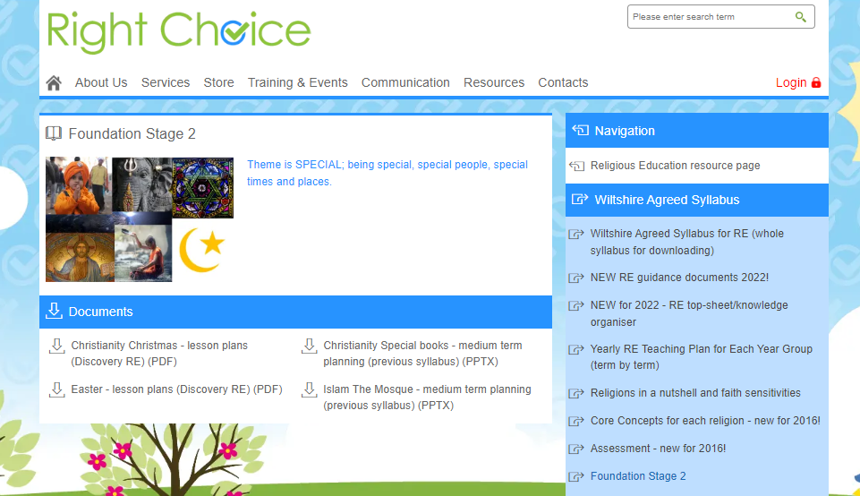
For Early Years, the overarching theme is 'SPECIAL'. The curriculum is divided up into Being Special, Special People, Special Times and Special Places.

Slide 7
The SPECIAL themes for EYFS are mapped out across the year and enquiry-based learning questions are used as a stimulus for each term. This is the same for both Year A and Year B.
Year A | Term 1 | Term 2 | Term 3 | Term 4 | Term 5 | Term 6
EYFS/Y1 | Being Special What things are special to me? Christianity | Christmas Why is Christmas a special time? Christianity | Special Books Which stories are special and why? Christianity | Easter Why is Easter a special time? Christianity | Special Places What makes a place special? Islam or Christianity | Special People Which people are special and why? Christianity

Slide 8
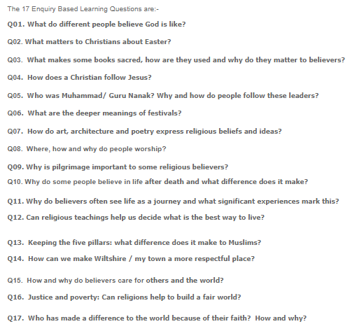
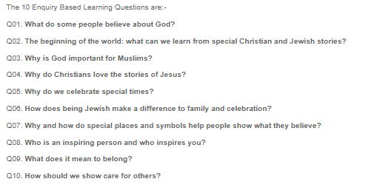
For Key Stages 1 and 2, Enquiry Based Learning Questions are used as a stimulus. There are 10 EBLQs for Key Stage 1 and 17 for Key Stage 2.

Slide 9
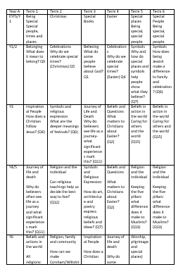
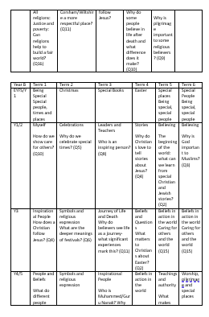
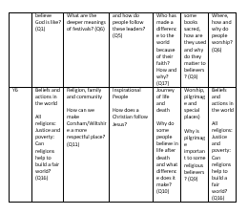
All of the enquiry-based learning questions for both Key Stages have been mapped out across a 2 year rolling programme. This ensures coverage and progression.

Slide 10
Our curriculum also encompasses these key attitudes
Self-awareness in religious education includes pupils:
- feeling confident about their own beliefs and identity and sharing them without fear of embarrassment or ridicule
- developing a realistic and positive sense of their own religious, moral and spiritual ideas
- recognising their own uniqueness as human beings and affirming their self-worth
- becoming increasingly sensitive to the impact of their ideas and behaviour on other people
Respect for all in religious education includes pupils:
- developing skills of listening and a willingness to learn from others, even when others‟ views
are different from their own
- being ready to value difference and diversity for the common good
- appreciating that some beliefs are not inclusive and considering the issues that this raises for individuals and society
- being prepared to recognise and acknowledge their own bias
- being sensitive to the feelings and ideas of others
Open-mindedness and questioning in religious education includes pupils:
- being willing to learn and gain new understanding
- engaging in argument or disagreeing reasonably and respectfully (without belittling or abusing others) about religious, moral and spiritual questions
- being willing to go beyond surface impressions
- distinguishing between opinions, viewpoints and beliefs in connection with issues of conviction and faith
Curiosity, appreciation and wonder in religious education includes pupils:
- developing their imagination and curiosity
- recognising that knowledge is bounded by mystery
- appreciating the sense of wonder at the world in which they live
- developing their capacity to respond to questions of meaning and purpose
Critical awareness in religious education includes pupils:
- having a willingness to examine ideas, questions and disputes about religious and spiritual questions
- distinguishing between opinions, viewpoints and beliefs
- developing the ability to argue respectfully, reasonably and evidentially about religious and spiritual questions
- being prepared to acknowledge bias and prejudice in oneself

Slide 11
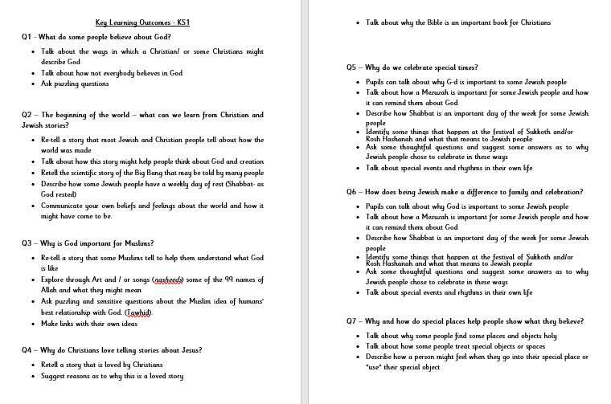
When planning, teachers begin by looking at the Key Learning Outcomes and then use resources from the Right Choice website to gather ideas. Where possible, teachers make the learning cross-curricular. They are given the freedom to create their own resources or adapt others that they find useful.

Slide 12
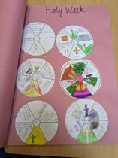
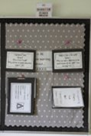
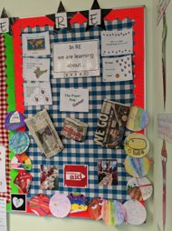
PROVISION
At the end of each term, classes take part in an RE Day (1 ½ days in Key Stage 2), focusing on one of the Learning Enquiry Based Questions. Children are given opportunities to share their own thoughts and beliefs, learn about a range of faiths from around the world and deepen their understanding through discussion. Where possible, lessons are cross-curricular, incorporating music, poetry, drama and art into the subject.​
​
Work is photographed, displayed in floor books and on displays and within the children's books.

Slide 13
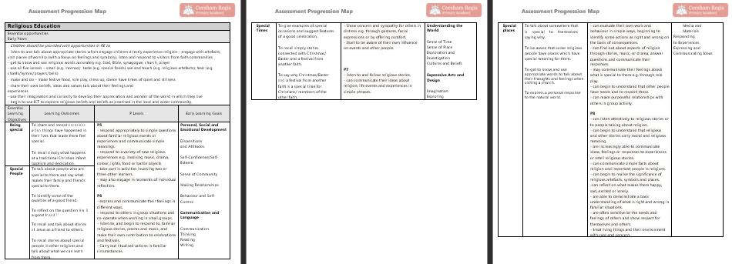
Assessment
Within Early Years, children are assessed using this progression map. P Levels are used to assess the children's knowledge, understanding and skills within the subject.

Slide 14
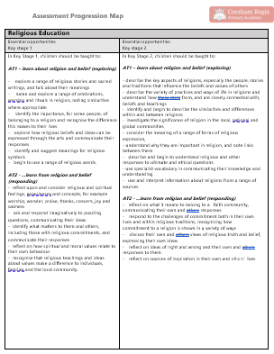
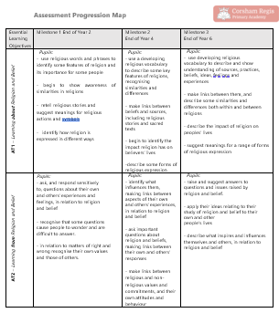
Assessment
Progression Map for Key Stages 1 and 2
Objectives for both AF1 (learning about religion and belief) and AF2 (learning from religion and belief) are broken down into milestones (End of Year 2, End of Year 4 and End of Year 6)

Slide 15
Assessment
Teachers use the Progression document to assess the children in their class and then enter the initials of those working below their year group and those working above their year group on this Milestone Subject Assessment Overview document.

Slide 16
STAFF AUDIT
Staff at Corsham Regis completed a staff audit for Religious Education.
The audit was broken down into four areas. These areas are:
Curriculum Intent
Curriculum Implementation
Curriculum Impact
Professional Development
Carrying out this audit enabled me to see which areas staff felt happy and confident within the subject and the areas they felt less confident.

Slide 17
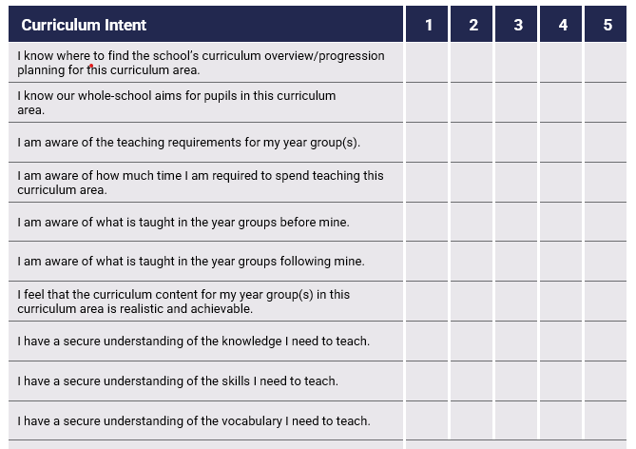
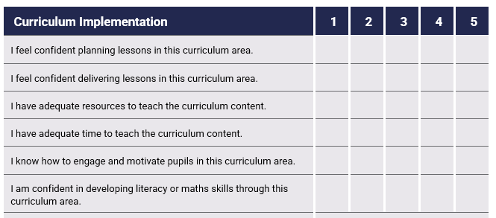
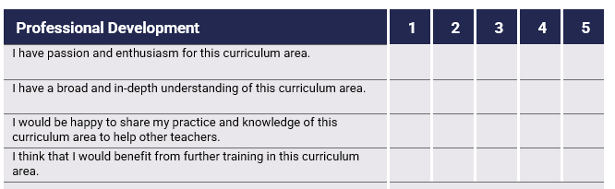

Slide 18
Confident
Understanding the skills, vocabulary and knowledge they need to teach.
Planning and delivering lessons within this subject.
Assessing pupils' learning and progress within this subject.
How to support pupils with SEND, within Religious Education lessons.
How to identify those who are working at greater depth.
Teachers are passionate and enthusiastic when teaching this subject.
Need more support
Accessing adequate resources to use within their lessons.
Using the Right Choice website.
Ensuring that the curriculum for their year group is pitched correctly.

Slide 19
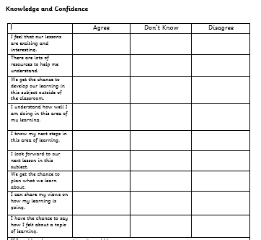
Children’s voice
Overall, pupils at Regis enjoy Religious Education days and love the cross-curricular links.
They look forward to the lessons and feel that they are interesting and exciting.
They thoroughly enjoy using artefacts, creating pieces of art and listening to music from different cultures.
Pupils were able to recall and talk about some key facts they had learnt within the subject however this was not consistent across the school.
Pupils feel listened to and respected when voicing their opinions and
ideas during Religious Education lessons.
They enjoyed the whole-school Judaism assembly, led by Iris Segall. The children
thought it was very informative and interesting and they would love to have more of
these assemblies.

Slide 20
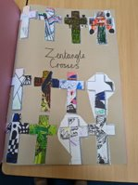
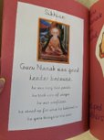
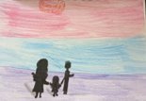

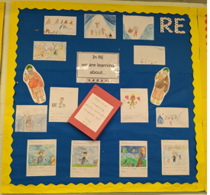
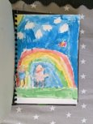
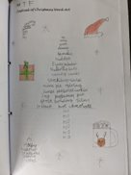
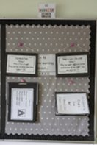
Evidence

Slide 21
End of 22-23 data for Religious Education | Working below | Working at ARE | Working at greater depth
Year 1 | 27% | 63% | 0%
Year 2 | 19% | 76% | 5%
Year 3 | 30% | 62% | 8%
Year 4 | 9% | 91% | 0%
Year 5 | 6% | 91% | 3%
Year 6 | 4% | 82% | 14%

Slide 22
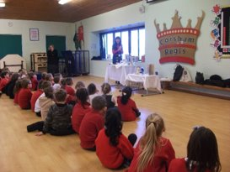
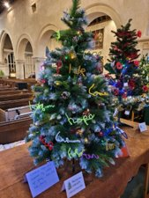
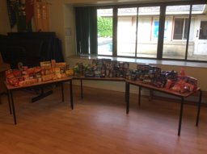
magic moments
A visitor from a Jewish synagogue in Bristol came into school to talk to the children about Jewish life and traditions.
We created a 'Regis Rainbow' with the donations collected for the Corsham Churches Foodbank.
Corsham Regis took part in the Christmas Tree Festival at St Bartholomew's Church.

Slide 23
Final reflection/next steps
To carry out a staff meeting, going over the Right Choice website and resources.
To ensure all staff are using a range of resources, including the artefact boxes.
To re-visit the overview, ensuring that it aligns with the current class structure at Regis.
To invite more visitors from other cultures into school, giving pupils a broad range of experiences.

