Slide 1
Subject Leader Impact Report
The Creative ARTS
2022-2023
Together Everyone Achieves More

Slide 2
Intent
How to communicate using appropriate vocabulary
In The Creative Arts at Corsham Regis pupils are encouraged to communicate and share their thoughts and ideas in a number of different ways; it could be explaining a design process, explaining how to improve a design or creative piece or it could be through the medium of singing. Listening also forms essential part of the music curriculum and children are encouraged to express what they see, hear and experience.
About Corsham and the local area
The pupils are encouraged to take inspiration from our locality for their artwork; this could be a walk around the town, a visit to Corsham Court or going into Bath. In addition to this, the pupils take part in the cluster singing event at The Corsham School or play the ukulele with teachers from Heywood School.
Through experience inside and beyond the classroom.
Children have opportunities to perform their music to the rest of the school, participate in concerts and also benefit from the experience of learning different instruments such as recorders, ukuleles and playing for a Wideband. In Ar,t they may experience a trip to an art gallery, benefit from lessons taught by experienced artists or displaying their own creations in our school gallery. Our relationship with The Brunel Shed provides us with lots of support in all our creative subjects too.
New knowledge and understanding appropriate to their age
The children are taught the National Curriculum for their year group with the Chris Quigley Milestones linking the topics. This is split over a two year rolling program to ensure coverage and gives the children the opportunity to deepen their knowledge and skills.
How to keep themselves safe
Creative Arts lessons are risk assessed and children are taught how to engage in activities safely. Children are taught how to use equipment safely in DT and appropriate clothing and hygiene measures are in place for cooking sessions.

Slide 3
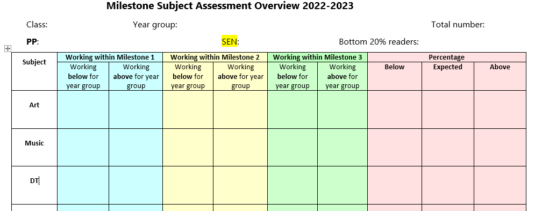
Implementation
Lessons are assessed against the milestones; also shown are pupils on the SEN register, EAL and pupil premium and this valuable information helps me to make decisions on the curriculum as well as needs and support in the classes.

Slide 4
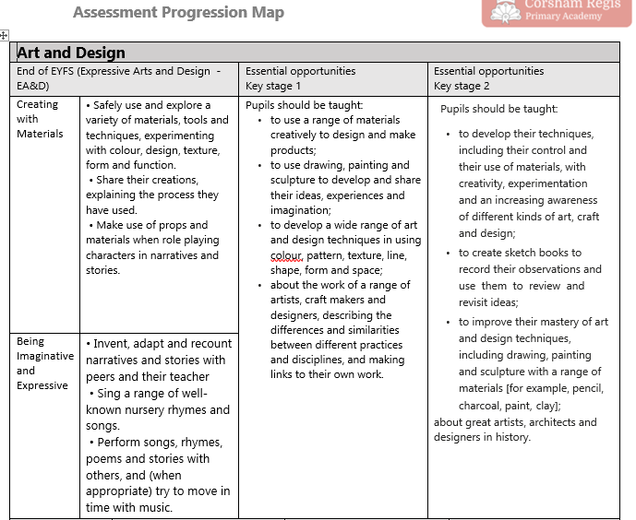
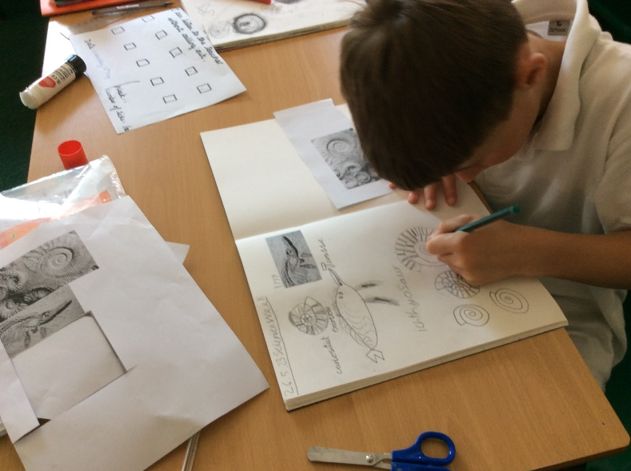
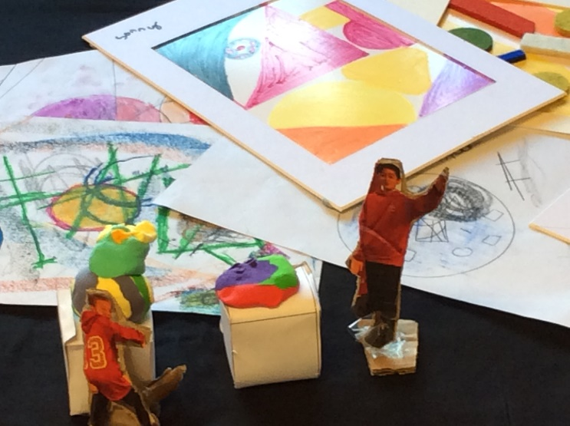
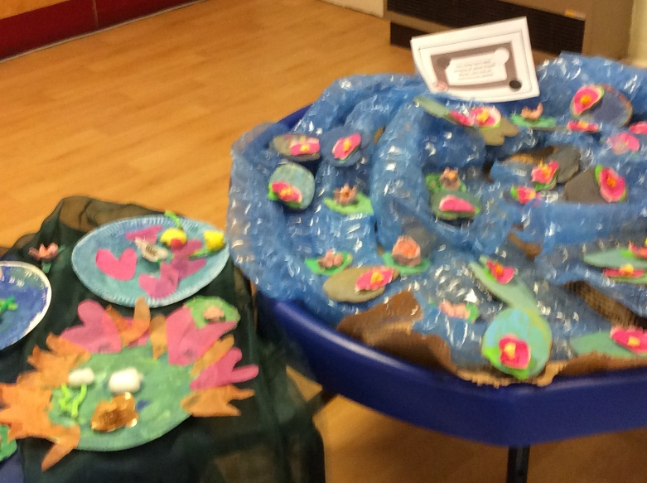

Slide 5
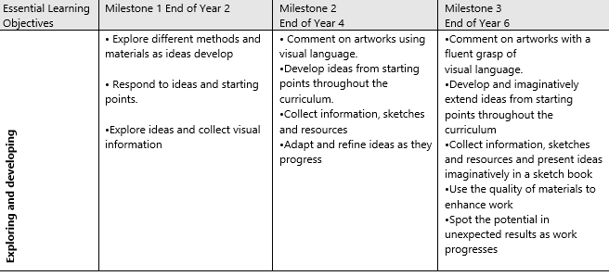
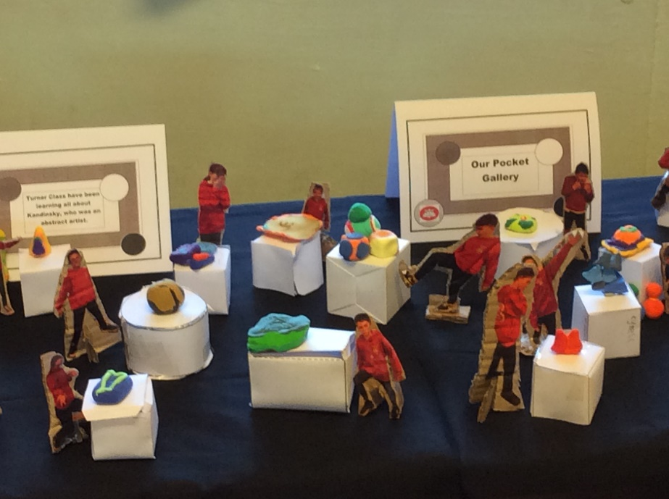
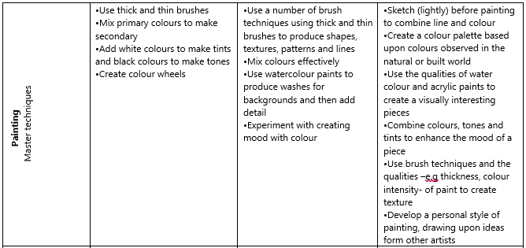
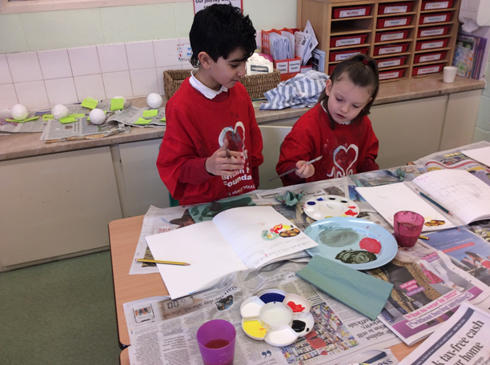

Slide 6
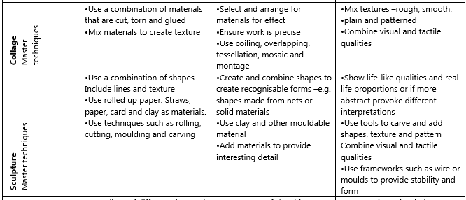
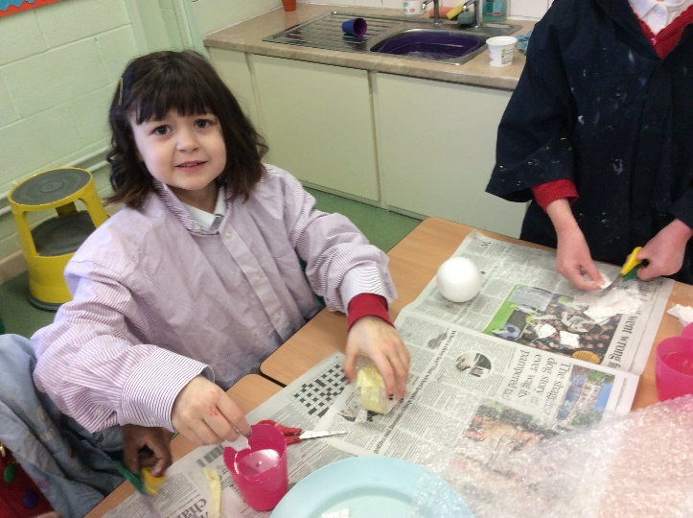
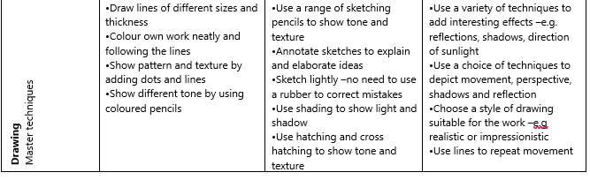

Slide 7
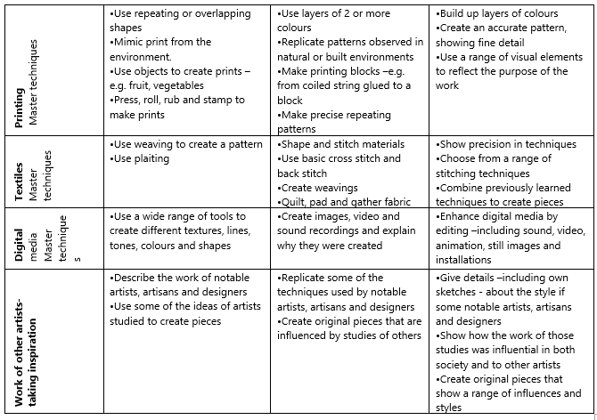
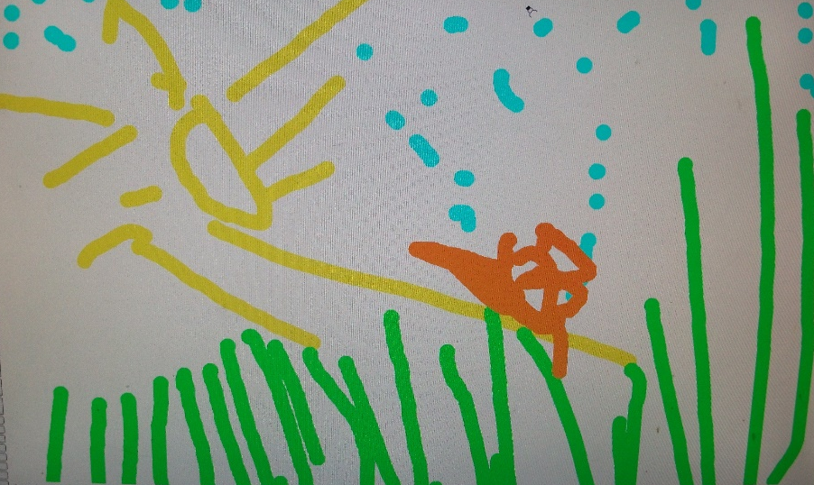
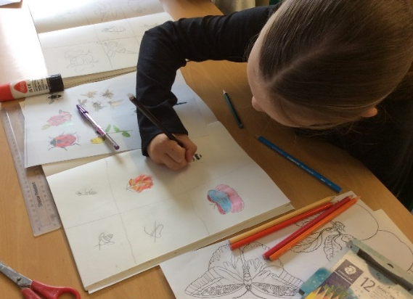
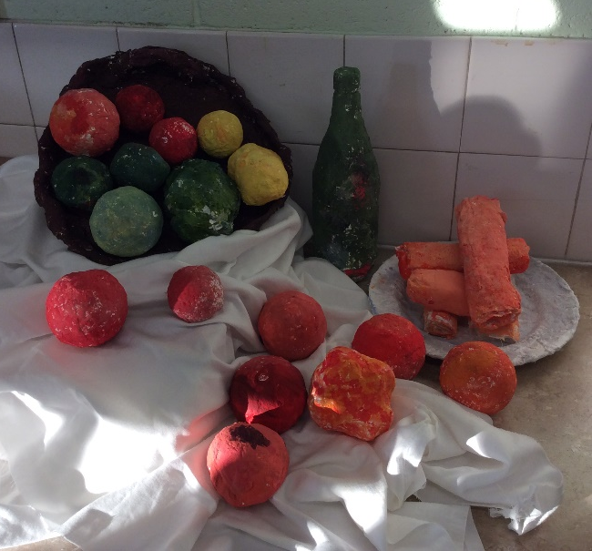

Slide 8
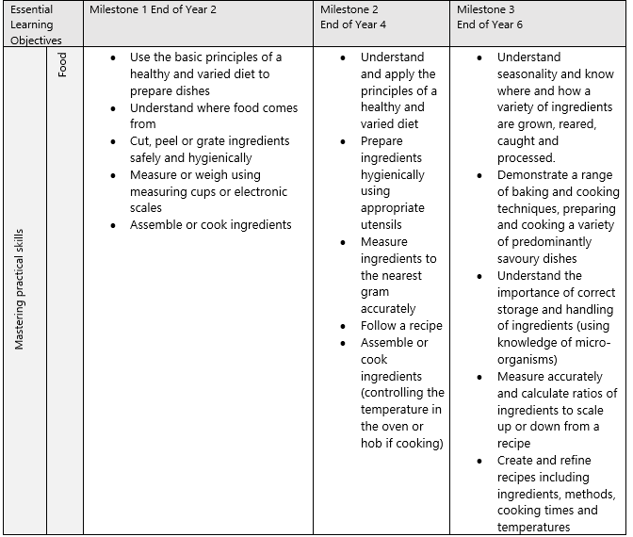
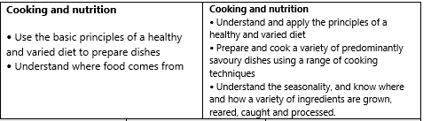
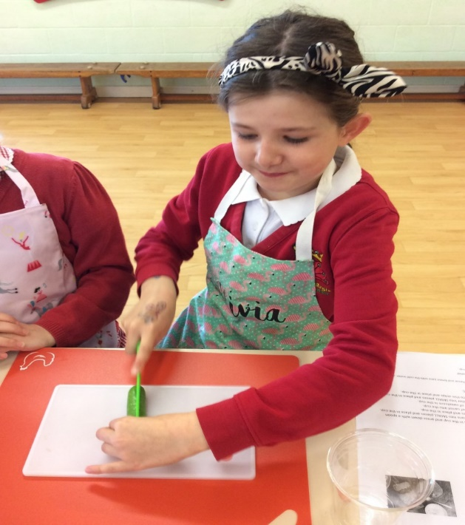
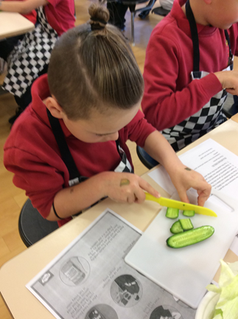

Slide 9
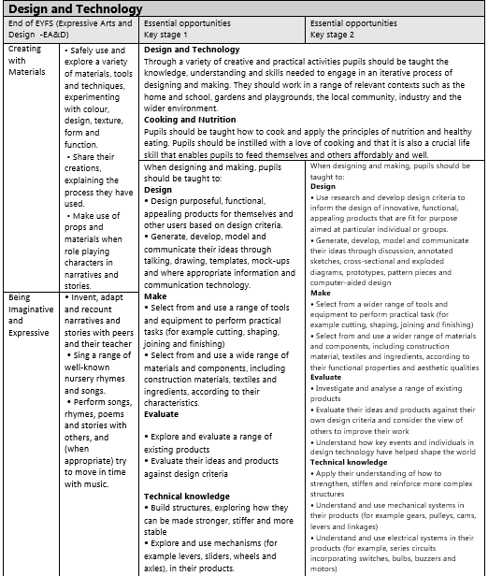
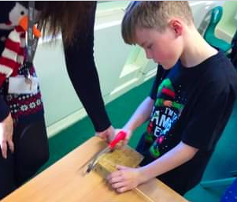

Slide 10
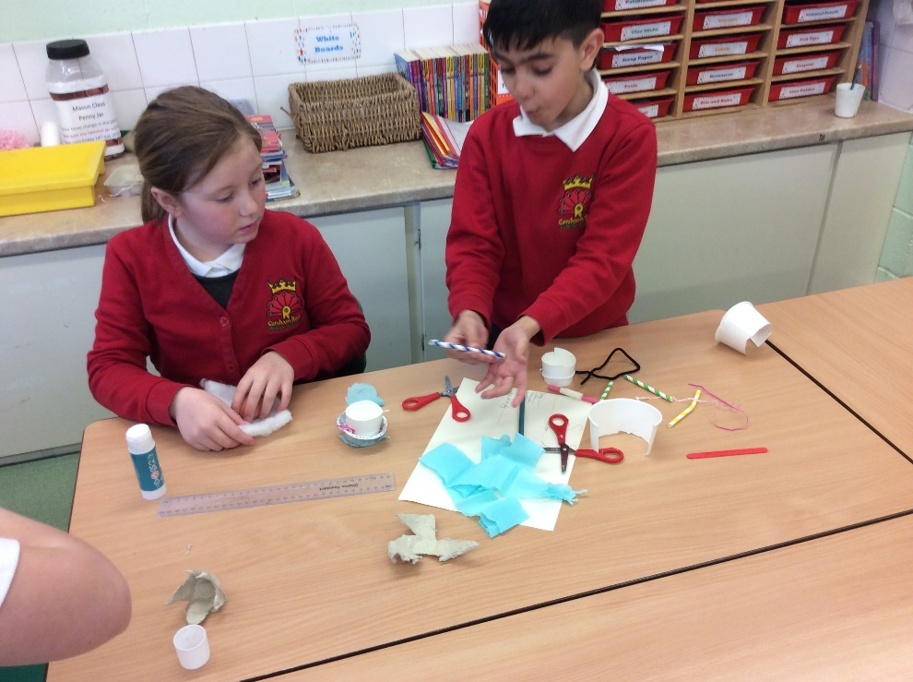
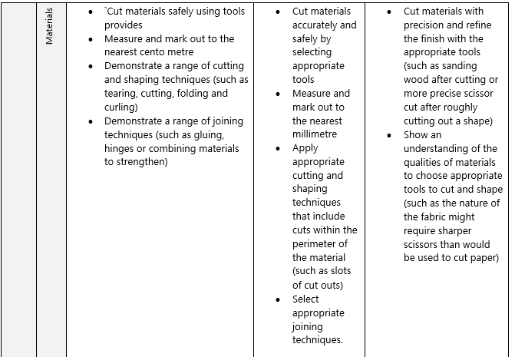
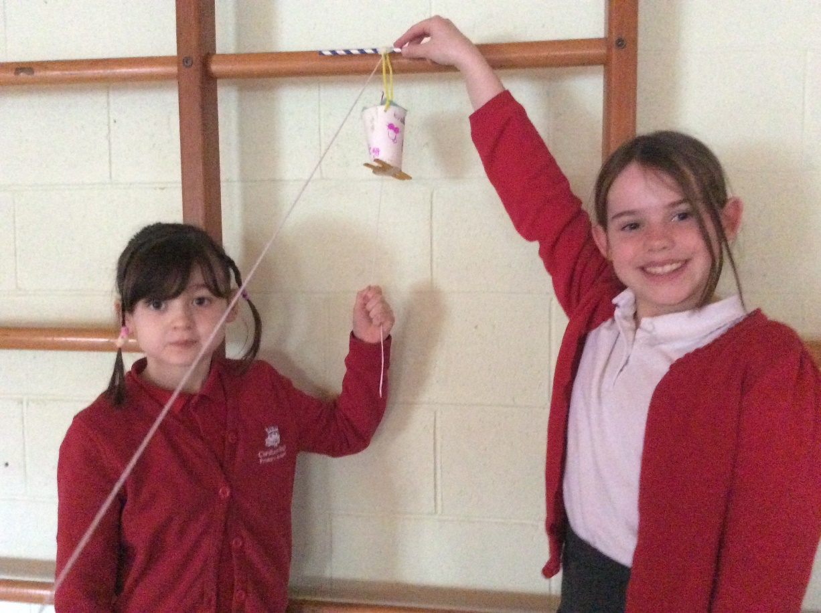

Slide 11
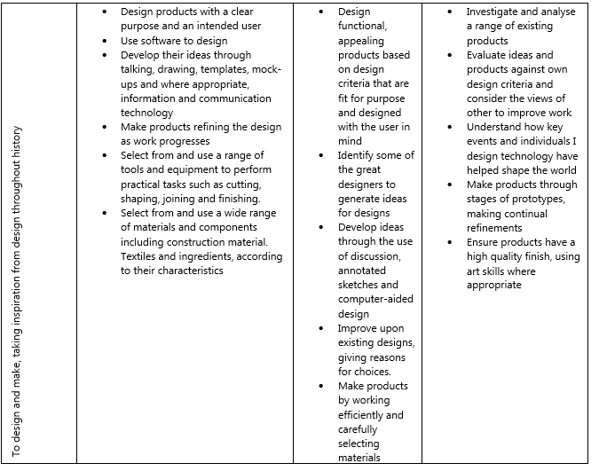
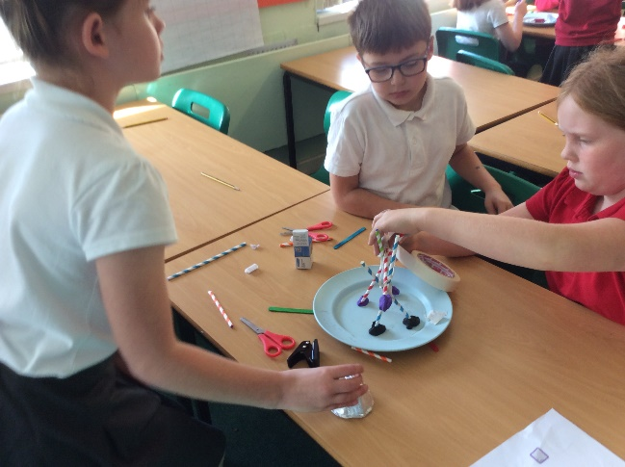
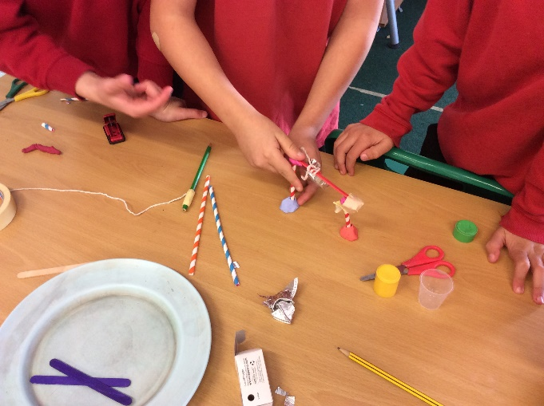
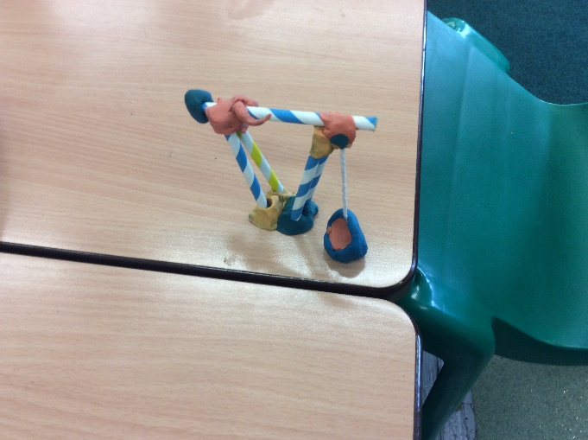

Slide 12

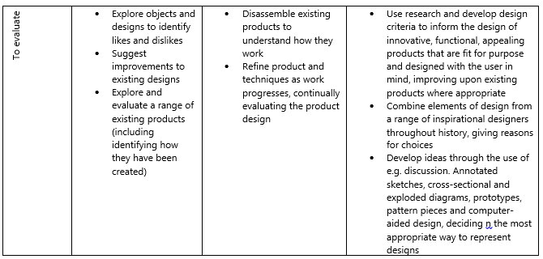
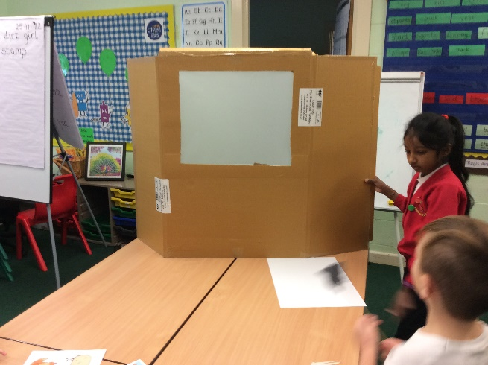
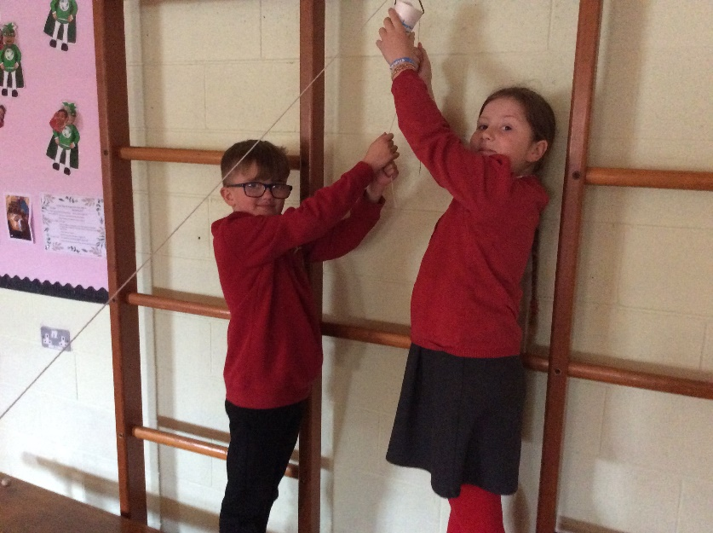

Slide 13
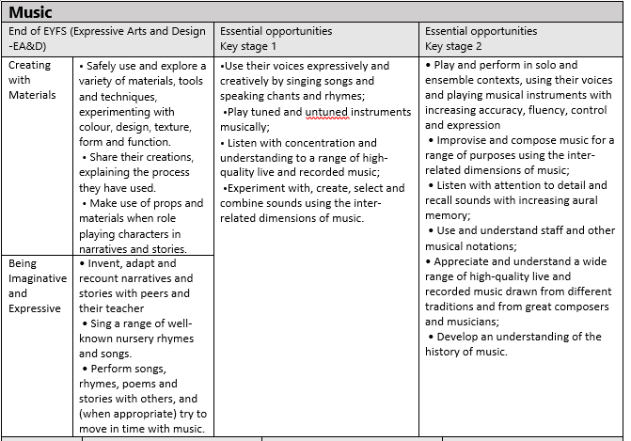
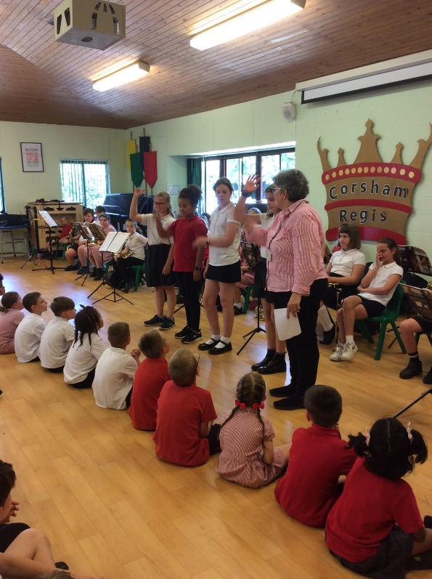
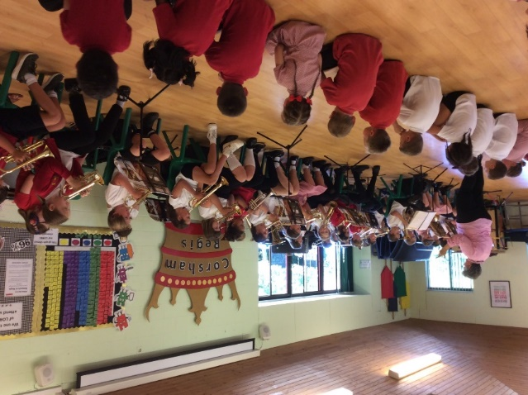

Slide 14
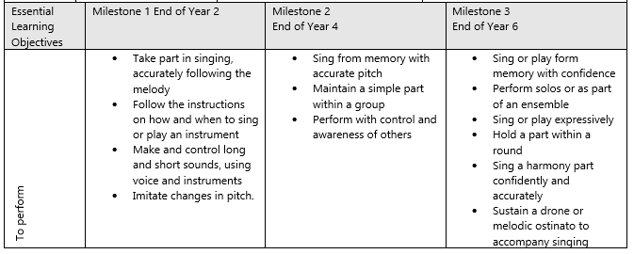
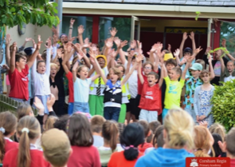
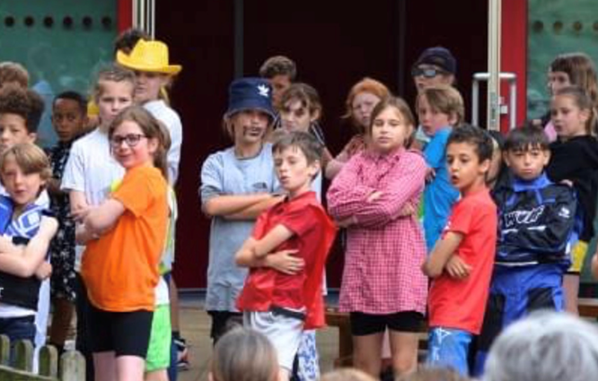

Slide 15
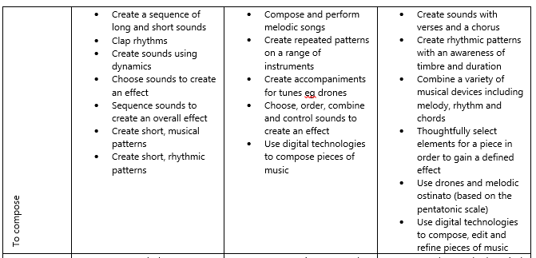
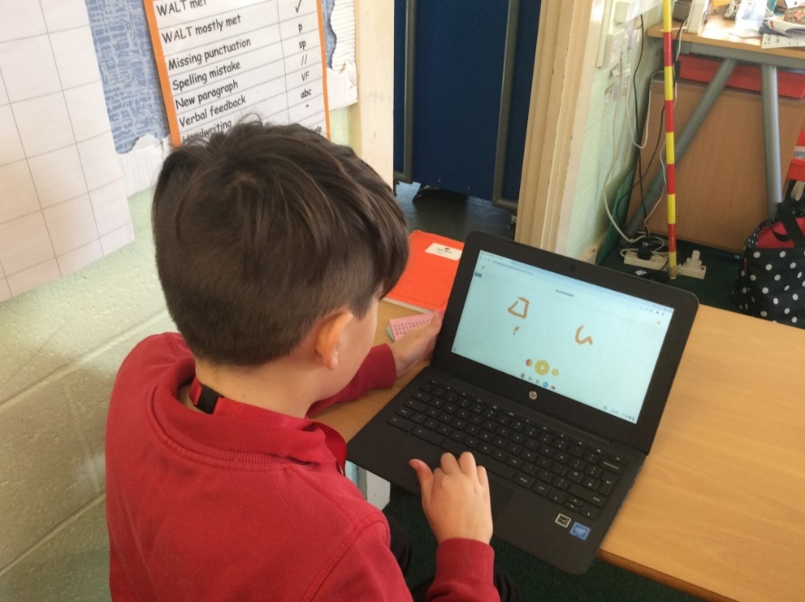
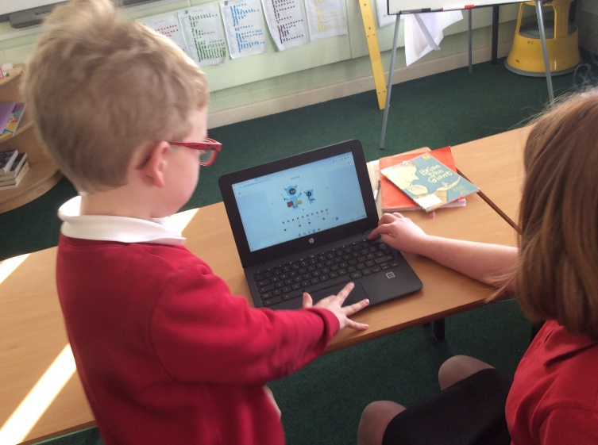

Slide 16
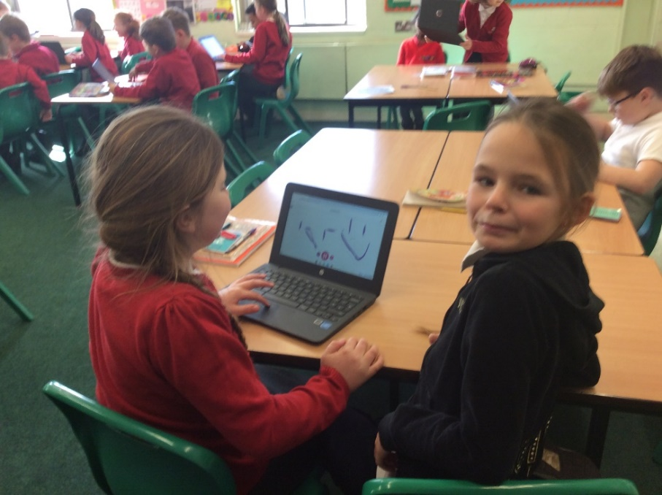
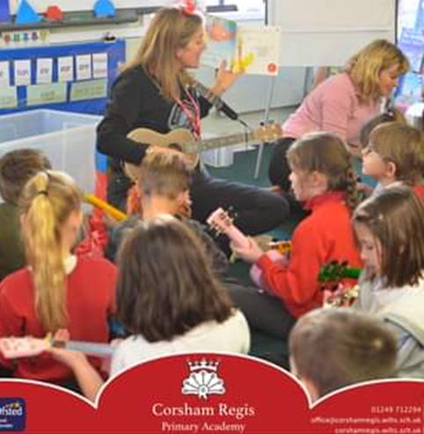
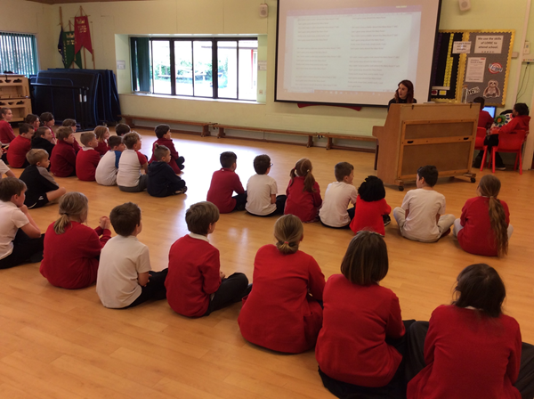
Provision
In Music pupils are given the opportunity to perform, sing, compose and listen

Slide 17
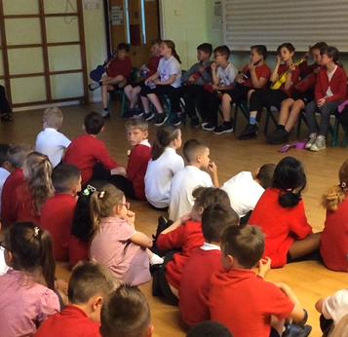
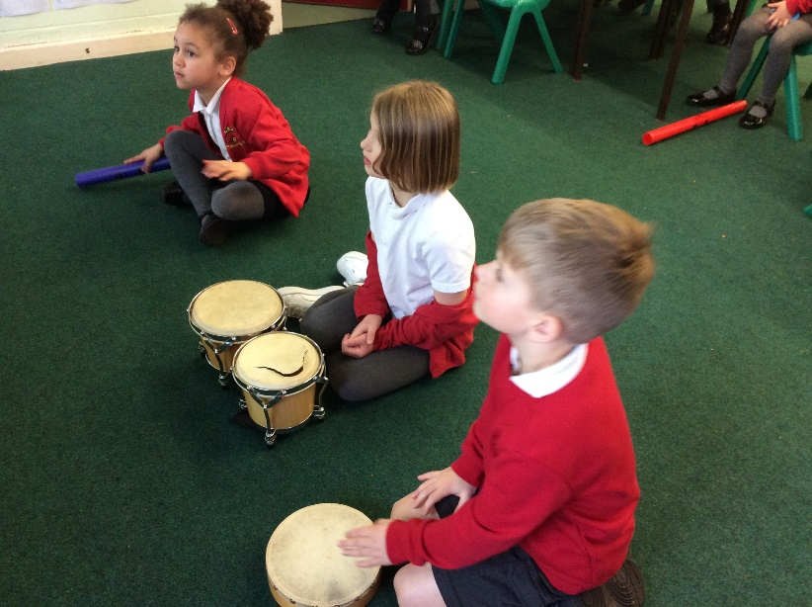
Music in Early Years and KS1

Slide 18
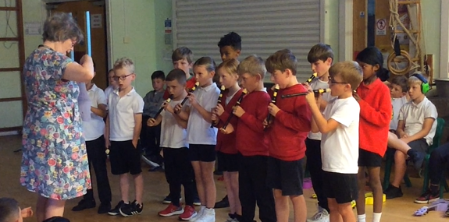
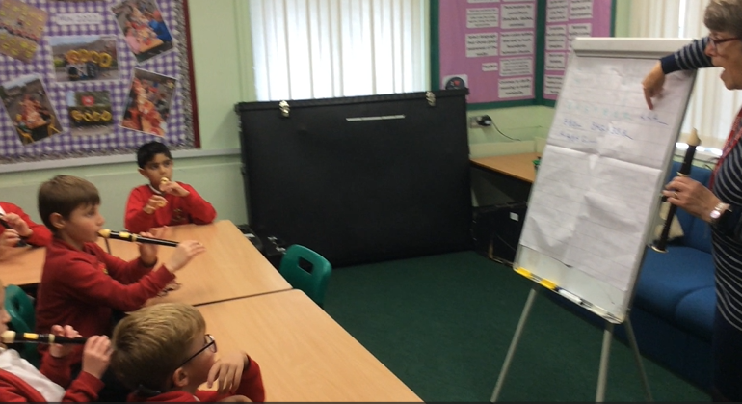
Provision
Impact
Pupils learn to play as an ensemble and learn to read music.
Pupils receive Recorder lessons in Y3.

Slide 19
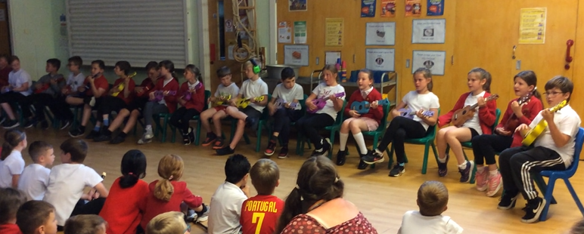
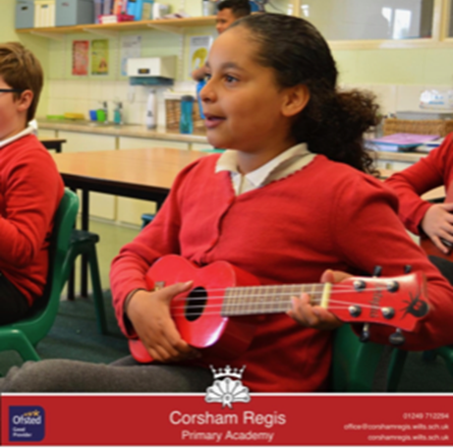
Provision
Evidence
Pupils learn to play a stringed instrument, read Tab and learn to strum, play and sing
Pupils learn the Ukulele in Y4
Pupils performed in a concert for their parents in the summer term

Slide 20



Y5 Windband
Evidence
Implementation
In year 5 pupils learned a wind instrument.
Impact
This included learning to read music and play as an as an ensemble. They also gave several performances including to parents and for a radio programme.

Slide 21




Provision
Pupils use an app to compose music
Impact
Pupils are able to experiment and compose their own music using a range of instruments, notes and rhythms.
Y6 compositions and performance
Provision
Pupils have the opportunity to put on a show at the end of the Summer Term. Along with the rest of KS2, they could also participate in the school choir and take part in a local cluster event.
Implementation
Pupils are able to attend choir and rehearse and perform the play.
Evidence: pupils are confident performers
Evidence: pupils enjoyed experimenting with composition.

Slide 22


In Art, Music and DT pupils are given the opportunity to explore and record, review and revisit their learning
Knowledge organisers help us to reflect, refer and retain what we are learning

Slide 23





Art: Early Years through to Y6
Impact .
Children are confident to share their ideas
Provision
Pupils are given plenty of opportunities to develop their skills and share their ideas.
Pupils have access to many resources and are encouraged to explore, practise and develop their ideas.
Evidence
Our Art Gallery

Slide 24



Sketching with opportunities to improve
Provision
Each pupil has their own sketchbook and understands it is owned by them Impact
Pupils are encouraged to explore and experiment with their ideas.
Evidence

Slide 25




DT
Provision
Pupils are able to use different resources and learn to work safely
Impact
Pupils are confident working in groups and using different materials and equipment.
Evidence

Slide 26



Outside the classroom and visitors for The Creative Arts
Provision and Implementation
Our WOW days help the pupils to gain experiences and strengthen their knowledge. These experiences bring the learning to life and help pupils discover new skills and interests.
Evidence

Slide 27






Creative arts and supporting learning in other subjects.
RE
Creative subjects can help embed learning across the curriculum
Science
IT
Story Telling

Slide 28
Children’s voice - ART
If I want to improve, we get to mark our own work I improve it then. When we did the pharaoh, I got to do it again. Y3 pupil
I enjoyed sketching large as life
Y4 pupil
I was inspired by Matisse.
Y5 pupil
I have learnt to use bright colours
Y1 pupil
I like the freedom to do my own creation
Y6 pupil
I like drawing my feelings
Y5 pupil

Slide 29
Children’s voice -Music
I enjoyed composing on the computer
Y6 pupil
To get better, I keep going and practise
Pupil Y4
When I read music on the music stand I feel like a real musician.
Pupil Y3
I like copying the music.
Pupil Y1
I like playing GCEA on the Ukulele
Y4 pupil

Slide 30
Children’s voice -DT
I liked designing the Lego rogotics.
Pupils Y6
I liked building the suspension bridges.
Pupil Y2
In DT I liked when we did the shadufs and how we talk about how to improve it when we have finished. Y3 PUPIL
When we did the experiment with the shadufs –it was really tricky to get it to stand and we solved the problem and I was proud. Y3 Pupil
I like working in groups.
Pupil 4

Slide 31





Regis Magic moments in THE Creative ArtS
These can come from

Slide 32
Academic Year 2023-2024
We really enjoyed our cluster singing project and would like to participate in a similar event and we are looking possibly further afield.
In art we would like to repeat the art gallery idea.
DT continue with our Easter Challenges and explore a permanent solution for our kitchens.
I would like to continue exploring computer aided designs.

Slide 33
Continue to develop music provision in line with the New Model Music Curriculum
Focus on how we can develop sketching and finding opportunities to sketch.
Increase the number of musical instruments, especially the ukuleles.
In Music develop our relationship with Heywood Prep.
In DT continue to work with The Brunel She who are currently making gears, axel and levers to use in the teaching of DT

