Slide 1
Subject Leader Impact Report
SEND
2022-2023
Together Everyone Achieves More

Slide 2
Intent
At Corsham Regis, we believe in providing every possible opportunity to develop the full potential of all learners. Our aim is that all learners with special educational needs participate in activities compatible with the efficient education of other learners and the efficient use of resources. All learners will have the right to a broad and balanced curriculum including extra-curricular activities where appropriate and full access to the National Curriculum. All learners are valued and their self-esteem promoted within the ethos of the Academy.
Parents/carers are important partners in the effective working relationship with the academy in raising their child’s attainment. They are fully involved in the identification, assessment and decision-making process in the academy. Parents/carers are encouraged to involve their child in the decision-making processes, including determining the level of participation, recording children’s views and implementing and reviewing their Education Plan.
We show sensitivity, honesty and mutual respect in encouraging children to share concerns, discuss strategies and see themselves as equal partners in the academy. Where possible, all children are involved in making decisions, as soon as they start at the academy. We encourage them to take ownership of their learning targets by discussing their targets and what they can do to improve. For children with SEN this includes discussing the strategies for success in their Education Plan. We involve them, when appropriate, in the review of their progress and in setting new goals and challenges.

Slide 3
Implementation (Approach to providing support)
At Corsham Regis, we have many approaches to providing support to our pupils, including:
Quality first teaching including highly effective differentiation.
Interventions.
Class concern/Individual Education Plan (IEP).
My Support Plan.
Education and Health Care Plan (EHCP)/ Statutory My Plan.

Slide 4
Implementation (further support)
At Corsham Regis, we have specially trained Teaching Assistants (TAs) with a wealth of knowledge and resources, which can be used to further aid our pupils, on a short or long term basis:
ELSA
Nurture
Thrive
Up and Under sports

Slide 5
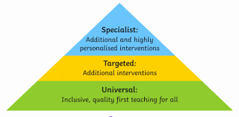
Provision (Quality first teaching)
The needs of the majority of learners will be met in the classroom. In all classes, teachers are responsible for the teaching and learning of all pupils, including those with SEND. The teacher plans for the activities to be given to the pupils at the appropriate level of need for success and progress to be achieved. If a learner is below age related expectations at half-term, or falls below during the year, then they become ‘Class concern’. The child is then discussed with the SENCo.

Slide 6
Impact
Evidence
All children receive a high quality education.
Children can have Teacher/TA support within the classroom.
As all children work together, it allows them to learn from each other.
Children make the progress within class, as can be seen on our trackers.
On talking to the children, it is clear they are happier to be supported in the classroom.

Slide 7




provision (interventions)
Sometimes it is necessary for children to do additional interventions, which usually take place in the afternoons, to further support their reading, writing or maths. In these instances, children are taken out of class to work in a small group with a Teacher or TA. These are high quality, short burst activities, that support the current class learning or aid the learning of a target. Some are planned by the Teacher/TA and some are through schemes.
Interventions can also provide emotional, mental health and well being support.

Slide 8
Impact
Evidence
Although we try not to remove the children from class too often, interventions target specific needs and learning that are better provided on a 1:1 or small group basis.
The children generally enjoy some 1:1 or small group time and it does make an impact on their learning/retention.
Children make progress due to extra interventions and support, which is recorded and analysed for each pupil.
On talking to the children, when they have a specific spelling target or tricky area of maths for example, they prefer to work out of class.

Slide 9
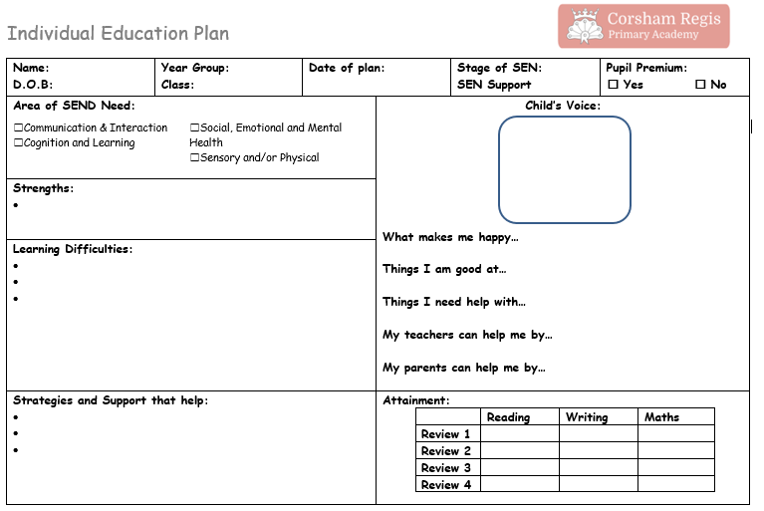
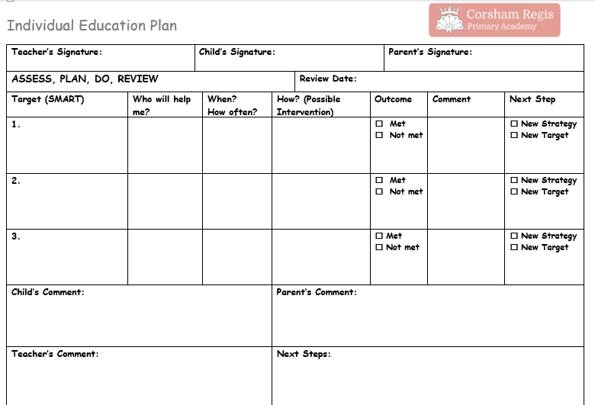
provision (individual education plan)
If a child continues to work below age-related expectations, despite the Quality First Teaching, an Individual Education Plan (IEP) will be put into place.
An IEP will be generated and monitored by both the class teacher and TA, as well as the SENCo. Targets are SMART and based on the learner’s needs/gaps.
Every 2 weeks, targets are assessed and every 6 weeks they are developed, changed or new approaches set. This includes a meeting to share with parents.

Slide 10
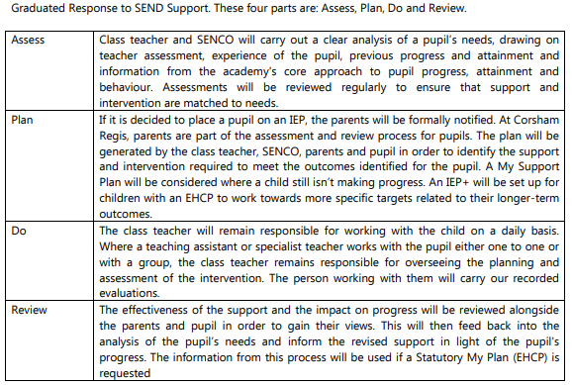
If the learner continues to make no progress, the Graduated Response to SEND Support will be used to access the child’s needs. At this point, consideration will be given as to whether any outside agencies are required.

Slide 11
Impact
Evidence
Pupils address their targets working 1:1 or within a small group, through high quality, short burst activities.
Progress is kept in motion by assessing the targets every 6 weeks, or more frequently if necessary, and new targets or approaches being set.
On revising the IEPs and monitoring, it is clear that many pupils achieve their targets within the 6 week time period.

Slide 12
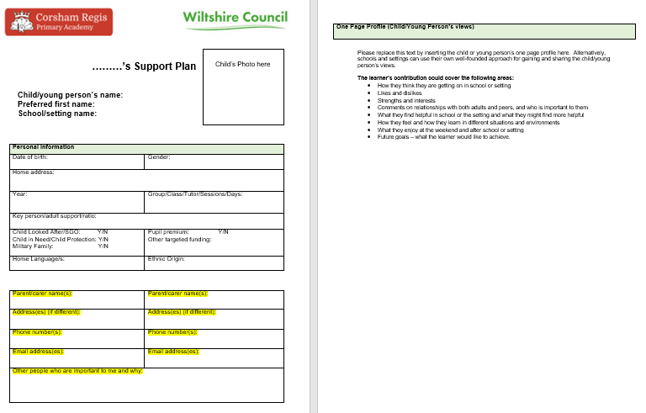
Implementation (my support plan)
A ‘My Support Plan’ is needed where an IEP has not been enough for the pupil to make the intended progress, or they have a diagnosis, such as ASD and their needs may increase over time. The targets on it are reviewed more frequently, the child is given additional support and outside agencies are consulted to provide additional support / strategies and ideas.
A 'My Support Plan' has the child at its centre and is still focused on SMART targets.

Slide 13
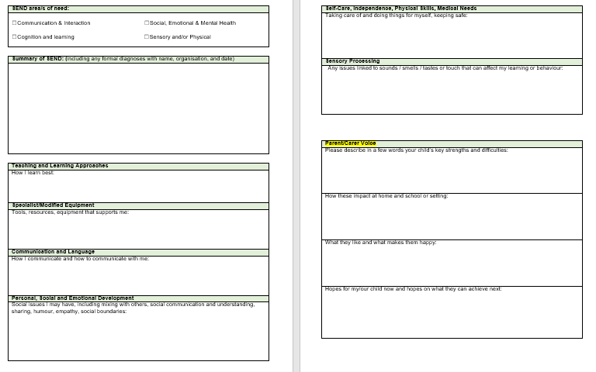

Slide 14
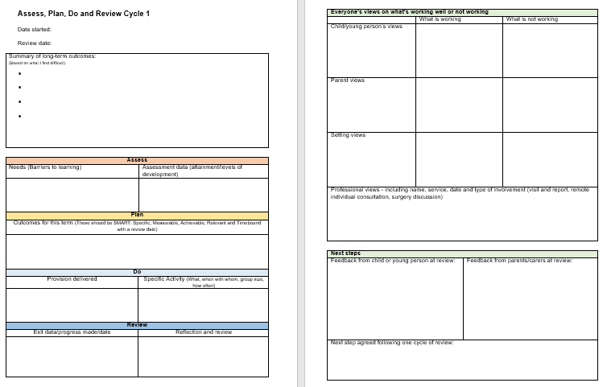

Slide 15
Impact
Evidence
My Support Plans help children to achieve through collaboration.
The evidence recorded in a My Support Plan is more detailed and helps with applying for an Education and Health Care Plan (EHCP), should one be needed in the future.
Parents with children on My Support Plans say they feel more supported, as they also have access to outside agencies.
This year, we have used My Support Plan evidence to successfully apply for 3 EHCPs.

Slide 16
provision (Education and Health Care Plan)
If, after the ‘My Support Plan’ has been in place and reviewed several times, it becomes apparent that very little or no progress has been made, an EHCP may be requested. This enables a learner to receive specific support in/out class partly funded by the LA. If a child has an EHCP, they will have broad, end of key stage/phase outcomes. From these outcomes, the class teacher and teaching assistant will form more specific and measurable targets. These will be recorded on an IEP+. These targets can then be reviewed at regular times throughout the year and will help to inform the discussion at an annual review meeting.

Slide 17
Impact
Evidence
An EHCP provides extra funding for the child, allowing schools to buy additional resources or provided TA support as necessary.
Outside agencies are involved, such as a speech and language therapists, who support the child at a deeper level with their specialist knowledge.
We see pupils with an EHCP make progress, at their own rate, through support, resources and individual timetables, helping them learn through things they enjoy and can relate to.
Pupils who have an EHCP receive a higher level of transition when they are transitioning to secondary school, in order to aid them with the changes.

Slide 18

provision (elsa)
An ELSA in a school is an Emotional Literacy Support Assistant. ELSAs are specialists with a wealth of experience of working with children and young people. They are trained and regularly supervised by Educational Psychologists. ELSAs are warm, kind and caring people who want to make children and young people feel happy in school and to reach their potential socially, emotionally and academically. They understand the barriers to learning that some children might have and can help them with this, supporting emotional development and helping to cope with life’s challenges. ELSAs will also support children and to find solutions to problems they might have. Relationships are key in helping children and feel safe and nurtured. ELSA is about creating a reflective space for the child or young person.
At Corsham Regis, our ELSA meets 1:1 with children with emotional/social needs, at least once a week. Activities and interventions are needs based and targeted for each child. It is a very hands on experience, with practical activities, as well as lots of conversation. It can be long term or short term, based on the needs of the pupil.

Slide 19
Impact
Evidence
Children come to ELSA having been acting out in class or at home or with emotional needs, and leave with the tools to self-regulate their emotions.
Children generally settle better in class after their ELSA sessions.
An ELSA assessment is completed by the child’s class teacher and then completed by the same teacher after the sessions have run their course, giving a clear visual of the progress made.
On talking to the children, they all really enjoy and are enthusiastic about ELSA and the support they reveive.

Slide 20
provision (nurture)
Nurture is about providing opportunities for children and young people to develop their social and emotional skills and understanding, in order to prepare them with the foundations that will help them build positive, healthy relationships as they grow up. It can help to increase their skills, coping strategies and their overall resilience and wellbeing.
Nurture at Corsham Regis Primary Academy is based around six key nurturing principles:
Children’s learning is understood developmentally
The classroom offers a safe base
The importance of nurture for the development of wellbeing
Language is a vital means of communication
All behaviour is communication
The importance of transitions in children’s lives.

Slide 21
Impact
Evidence
Children come to nurture with gaps in their formation years: poor social skills, emotional literacy, family situations, and they need a safe place to go.
Regular discussion with the class teacher shows the children are settling back into class and are making progress.
A Boxall shows the children’s current levels at the beginning, and when it is completed again on the child’s exit from nurture, the levels are usually much more positive.
On talking to parents and teachers, they feel the children who have attended nurture make progress with their social and emotion skills, allowing them to thrive in class.

Slide 22

provision (thrive)
Thrive at Corsham Regis is all about being in tune with the child, creating a safe and friendly atmosphere and helping them develop their ‘being’, doing’ and ‘thinking’ . Regular 1:1 sessions build a good relationship between provider and child, completing child led activities that link to the child’s needs.
The Thrive Approach is underpinned by science and theory:
Attachment Theory
Child Development Theory
Neuroscience
Play, creativity and the arts

Slide 23
Impact
Evidence
Children attending Thrive can go from being very stressed and upset to happy and relaxed within the session.
Children increase their age based levels through practical activities and conversation.
By populating an emotional development checklist, this pin points whether they need to work on their being, doing or thinking and activities match their current age, with the aim to bring it up to their current age.
The comparison checklists, completed when the child is exiting the programme, usually show massive progress in all areas.

Slide 24
provision (up and under sports)
Up and Under provide small groups of selected children with time in which to not only exercise and learn/practice a sport together, but also to work on communication, leadership and turn taking skills.

Slide 25
Impact
Evidence
Children get a chance to develop key skills in a small group environment.
Children can apply those skills back in the classroom or in real life situations.
Teachers can see improvements in their pupils’ leadership, communication and turn taking skills.
On talking to the children, it is clear they enjoy the activities and greatly benefit from the time.

Slide 26
Data (2022/2023 FS1)
EYFS detailed data breakdown
23 pupils- 18/23 (78.2%) children achieved GLOD
Communication and Language (Prime area) | PSED (Prime area) | Physical Development (Pr area) | Literacy (Spec area) | Mathematics (Specific area) | Understanding the World (Specific area) | Expressive arts and design (Specific area)
19/23 82.6% PP- 8/9 (89%) | 20/23 86.9% PP- 8/9 (89%) | 21/23 91.3% PP- 8/9 (89%) | 18/23 78.2% PP- 8/9 (89%) | 20/23 86.9% PP- 8/9 (89%) | 19/23 82.6% PP- 8/9 (89%) | 21/23 91.3% PP- 8/9 (89%)
G- 9/11 (82%) B- 10/12 (83%) EAL- 4/6 (67%) SEN- 1/2 (50%) | G- 9/11 (82%) B- 11/12 (92%) EAL- 5/6 (83.3%) SEN- 1/2 (50%) | G- 10/11 (91%) B- 11/12 (92%) EAL- 6/6 (100%) SEN- 1/2 (50%) | G- 9/11 (82%) B- 9/12 (75%) EAL- 3/6 (50%) SEN- 1/2 (50%) | G- 10/11 (91%) B- 10/12 (83.3%) EAL- 5/6 (83.3%) SEN- 1/2 (50%) | G- 9/11 (82%) B- 10/12 (83%) EAL- 4/6 (67%) SEN- 1/2 (50%) | G- 10/11 (91%) B- 11/12 (92%) EAL- 6/6 (100%) SEN- 1/2 (50%)

Slide 27
Data (2022/2023 ks1)
Key stage One detailed data breakdown
19 Year 2 pupils were assessed using the SATs tests combined with teacher assessments; there are 5 SEND pupils.
Reading
19 Year 2 pupils were assessed using the SATs tests combined with teacher assessments in reading :
1 (20%) SEND achieved.
Writing
19 Year 2 pupils were teacher assessed for writing: 0 (0%) SEND achieved.
Maths
19 Year 2 pupils were assessed using the SATs tests combined with teacher assessments: 0 (0%) SEND achieved.
Science
19 Year 2 pupils were teacher assessed for science: 2 (40%) SEND achieved.

Slide 28
Data (2022/2023 ks2)
Key stage Two detailed data breakdown
20 pupils were assessed using tests for Reading, Maths and SPAG and teacher assessed for Science and writing. All children were present for the tests. There are 7 SEND children.
Writing SEND 57% (4/7) with 0% at GDS
Maths 6/20 children in Maths scored a scaled score of 96-99 out of 100 (30%)
In mock maths test, which was 2 weeks before 40% achieved EXS
SEND 14% (1/7) at EXS
Reading SEND 71% (5/7 children) at EXS
GPS SEND 28% (2/7 children)
Science SEND 57% at EXS

Slide 29
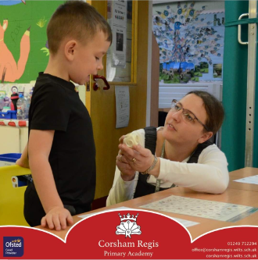
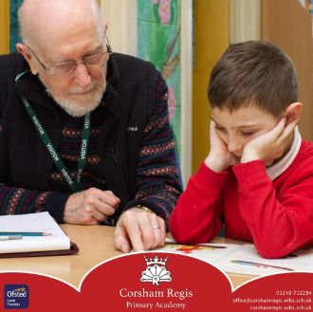
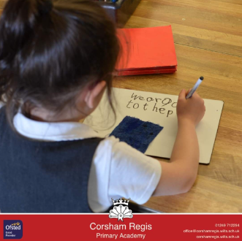
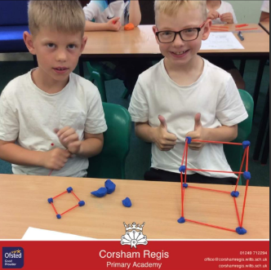
Photos/ regis magic moments

Slide 30
Final reflection/next steps
This academic year, we have successfully applied for and received EHCPs for 3 children. The next steps are to implement timetables, targets, support and carry out annual reviews.
Some children in each class have been taken off their IEPs, as they have closed the gaps in their learning through the additional support.
Nurture and ELSA have requested and been granted some interesting, exciting and useful resources.
Our nurture room leader would like to update her knowledge, so we will send her on a course in the next academic year.
We have a good link with the Behaviour Support Team and an Educational Psychologist and will continue to utilise their services.
We are really pleased with the progress of the SEND children this year and strive for them to continue on their learning journey.

