Slide 1
Subject Leader Impact Report
PSHE
(Learn for Life)
2022-2023
Together Everyone Achieves More

Slide 2
Intent
PSHE (Personal, Social and Health Education) encompasses all areas designed to promote children’s personal, social and health development. It gives children the knowledge, skills and understanding that they need to stay healthy and safe, develop worthwhile relationships, respect differences, develop independence and responsibility, and make the most of their own abilities and those of others.
How we communicate using appropriate vocabulary:
We use the Wiltshire Learn4Life scheme which provides the children with a wide range of activities and resources to support their learning. This programme supports the children with
their emotional literacy and regular circle times give children opportunities to express themselves in a nurturing context where they develop the vocabulary they need to express their feelings and experiences. It is a complete scheme of work for years 1 to 6, which is designed to integrate the SEAL emotional literacy materials with the wider aspects of the PSHE Education curriculum
About Corsham and the local area
Learn4Life was written by Wiltshire teachers for Wiltshire teachers and Wiltshire pupils. This ensures that the needs of our children are met both for the locality they live in and more globally.
We also provide visits from local professionals such as the community police and school nurse. We believe these links to our local community enable our children to feel connected and to be taught by members of the community in which they live.
Through experience inside and beyond the classroom
PSHE helps children to develop self-awareness, motivation, social skills and
managing their feelings. These skills will help our children to become better learners, get on better with other people and be responsible citizens. They are part of every area of life.
Through discussion, roleplay, debate and group activities we give children skills for life. We want our children to develop self-awareness, positive self-esteem and confidence, enabling them to:
stay as healthy as possible
Keep themselves and others safe
have worthwhile and fulfilling relationships
respect the differences between people
develop independence and responsibility
play an active role as members of a democratic society
make the most of their own abilities and those of others
behave in a socially and morally acceptable way including towards
authority and each other
to become involved in the life of their community
to know about democracy and how to be an active citizens
to know about economic wellbeing.
We want our children to:
value the achievements they make, and the achievements of others
make informed choices about dealing with risks and meeting
challenges now and in the future.
New knowledge and understanding appropriate to their age
Through regular staff training, both in-house and as part of teachers professional development, we are able to be confident that our pupils are given the most up-to-date and relevant resources and teaching. Our strong links with the Wiltshire PSHE advisor ensure our teaching and learning is appropriate to the age of the children.
Our PSHE curriculum promotes spiritual, moral, social and cultural development and prepares all pupils for the opportunities and responsibilities within their lives at a level which matches their maturity.
How to keep themselves safe
Through regular teaching around the themes of online safety, cyber-bullying, dangers inside and outside the home, we give the children clear and engaging lessons which are designed to make them aware of the dangers that
they may face both out and about in the world and online. To raise the profile
of such an important part of our curriculum we hold regular themed weeks and days particularly around the topics of bullying and online safety

Slide 3
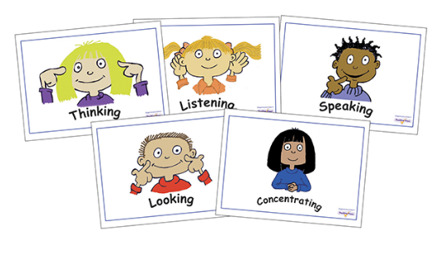
Implementation
PSHE (Learn for LIFe) is taught across both key stages and is timetabled weekly. It builds on the PSED teaching and learning in EY/FS2.
The vast majority of lessons start with a circle time which may link to the lesson content or can be used as a vehicle to resolve issues that the children face at school and beyond as they arise.
During circle times children focus on Jenny Mosley’s 5 skills:

Slide 4

Implementation
Most lessons are based on the Wiltshire Learn4Life Scheme:
Learn 4 Life was written by Wiltshire teachers for Wiltshire teachers. It is a scheme of work for years 1 to 6, designed to integrate the SEAL emotional literacy materials with the wider aspects of the PSHE education curriculum.
The Children's Charter for PSHE Education, produced by children from Wiltshire primary schools was a key document used to develop this scheme of work.
However, this no longer covers all the national requirements for PSHE so we have adapted our curriculum and have created a bespoke document to integrate Learn4Life with the Relationships and Sex Education Framework and to ensure we provide regular lessons about CSE, this may well be linked to online safety or RSE or when needed and appropriate may be taught discretely.

Slide 5
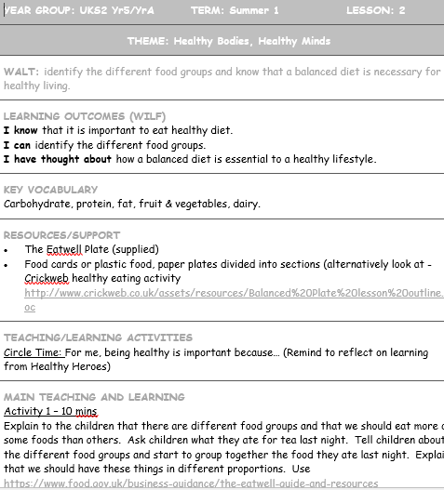
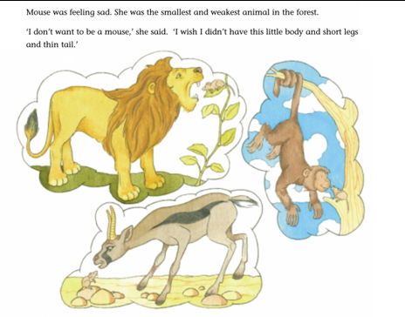
Adapted L4L planning
Well-loved resources which help the children to easily access the learning objectives.

Slide 6
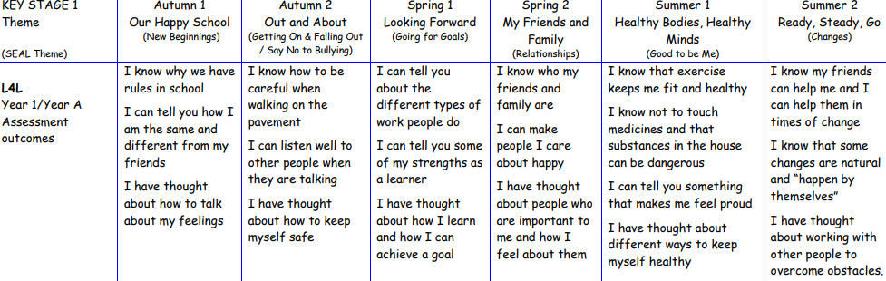
Our provision is built around 6 themes, one for each term and repeating each year, enabling us to revisit and extend the children’s learning.
From implementation to provision…

Slide 7

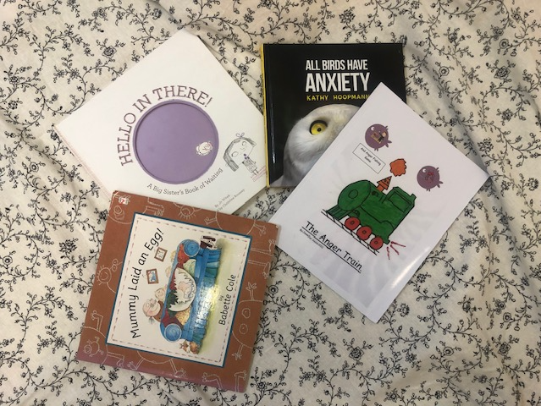
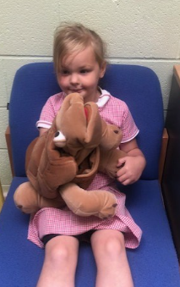
Adding to this a wide range of quality resources..

Slide 8
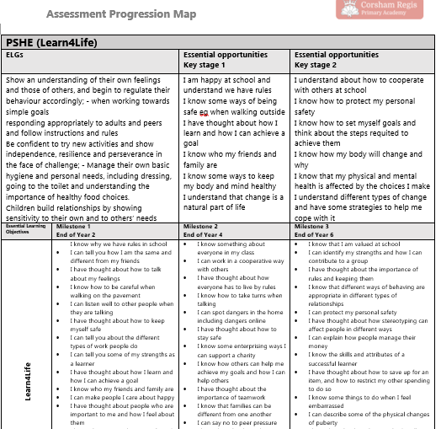
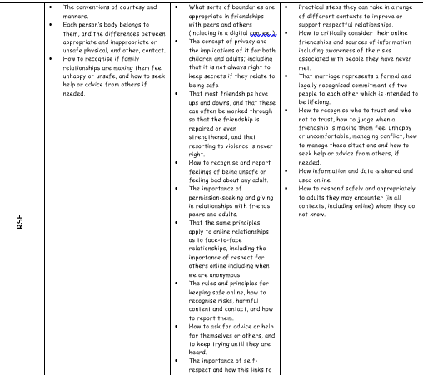

Provision
Our PSHE teaching, learning and assessment cycle is now inline with the foundation subjects, the teaching staff as a team having decided upon our essential opportunities and milestones.
We then use Remark on the Remarkable Assessment creating the perfect transition tool.

Slide 9
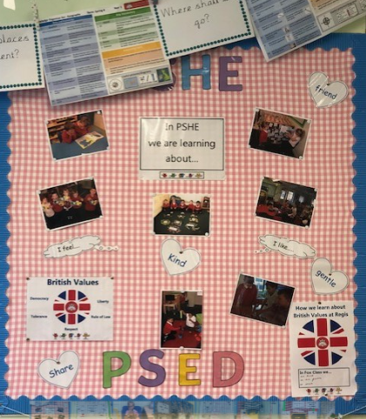
ImPACT & EVidence
Across the school, PSHE is a valued subject, for staff and children alike…

Slide 10
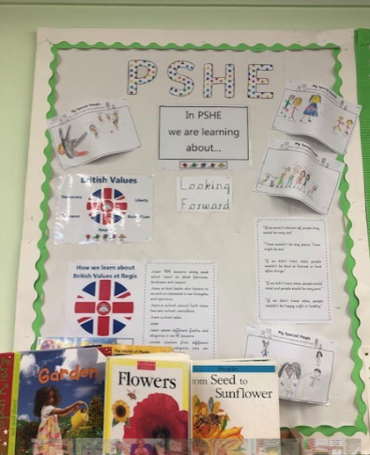
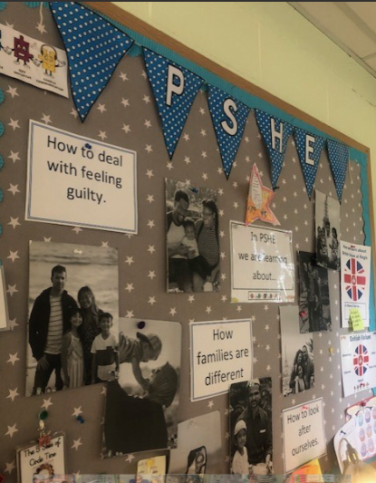

Slide 11
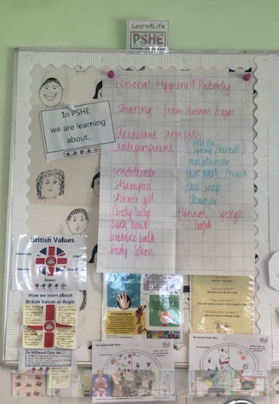
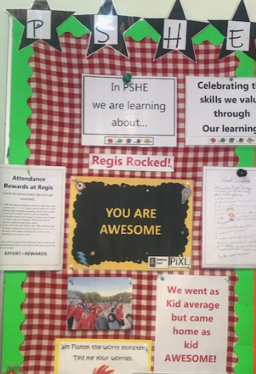

Slide 12
Evidence: Children’s voice
What do you do in Learn4Life/PSHE lessons? What are the different activities?
Healthy Heroes and the food plate-about what to eat.
Milk and calcium and teeth.
It’s about what is good for you. We did it in Circle time. What’s good and what’s not.
We learnt about alcohol. We had a body chart and had to show where it affects. We stuck on little pictures of alcohol.
We drew special people. It’s on our display.
We do debating and have sides and people watch and have a chairperson

Slide 13
What are your favourite activities?
Choosing my favourite power
Circle Time
British Values –if you were the queen
The acting out scenes
Because you could be anything you want and made me think about being a hero, about power. We learned not to be greedy not to have too may powers. You had to choose from all of them and you could only have three.
How do you think it has helped you?
To know not to smoke and I got to do something I enjoy-acting
I like when you listen to other children because I know what they do and what they think.
Making decisions, being in charge.
To follow your dreams, say what you’re feeling

Slide 14
Final Reflection
What has PSHE taught you?
Helps you know what is good for you and how being a child isn’t easy.
Rhea, Age 10

