Slide 1
Subject Leader Impact Report
Physical Education
2022-2023
Together Everyone Achieves More

Slide 2
Intent
How to communicate using appropriate vocabulary
At Corsham Regis, we aim to deliver high-quality physical education which inspires all pupils to leave us physically literate and with the knowledge, skills and motivation necessary to equip them for a healthy, active lifestyle and lifelong participation in physical activity and sport. We understand that pupils need to be taught to use appropriate vocabulary in order to achieve this.
About Corsham and the local area
On occasions, our sports teams or classes of children are invited to compete or participate in Corsham cluster sports festivals or competitions. These take place in and around Corsham, for example Corsham Rugby and Cricket Club, The Corsham School, Stanley Park in Chippenham and the Springfield Campus.
Through experience inside and beyond the classroom.
Children experience physical education in our school hall, on our school playgrounds and on our school field. Swimming lessons take place in our local swimming pool, which can be found at the Springfield Campus.
New knowledge and understanding appropriate to their age
The children are taught the National Curriculum for each year group with the Chris Quigley Milestones linking to their topic. This is split over a two year rolling program to ensure coverage and gives the children the opportunity to deepen their knowledge and skills.
How to keep themselves safe
Physical Education lessons are risk assessed and children are taught how to engage in activities safely. They are expected to dress in appropriate PE kit and remove unsafe jewellery. Pupils in Years 5 &6 are also taught aspects of water safety as part of their swimming lessons.

Slide 3
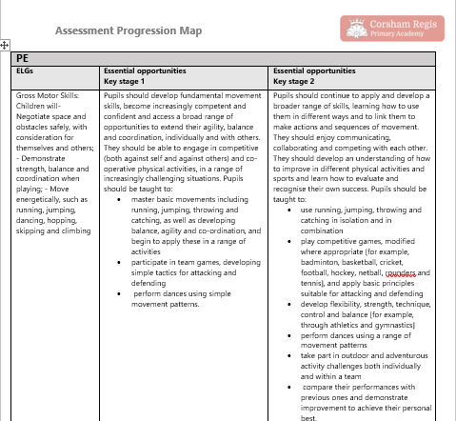
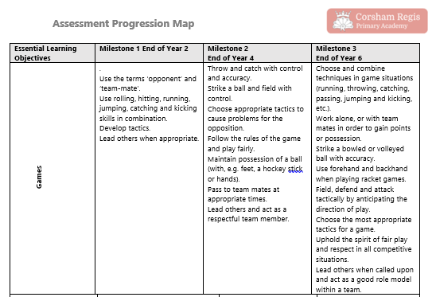
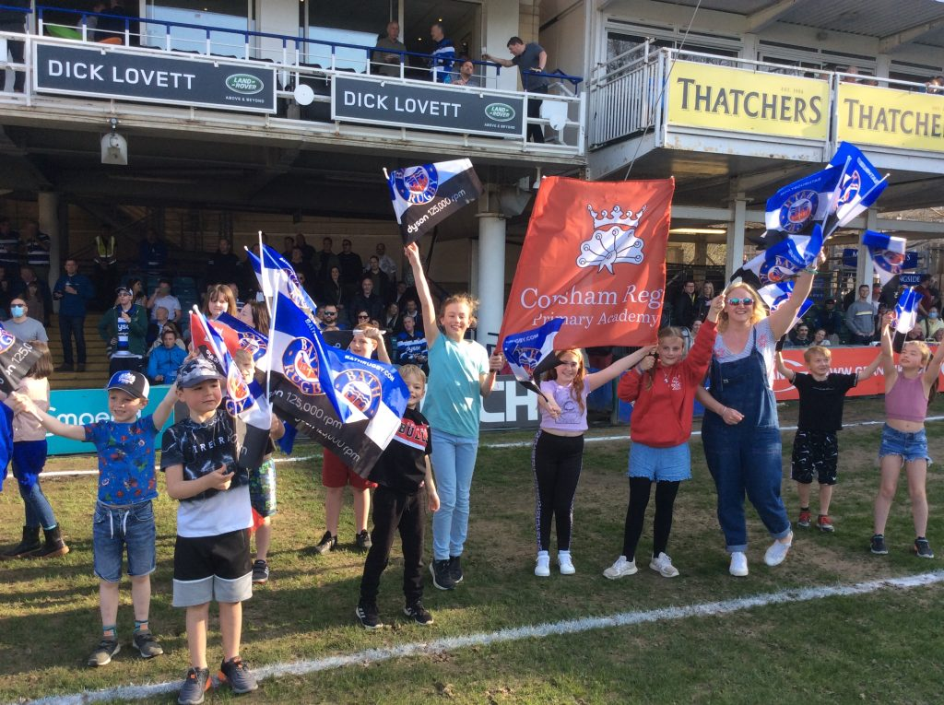
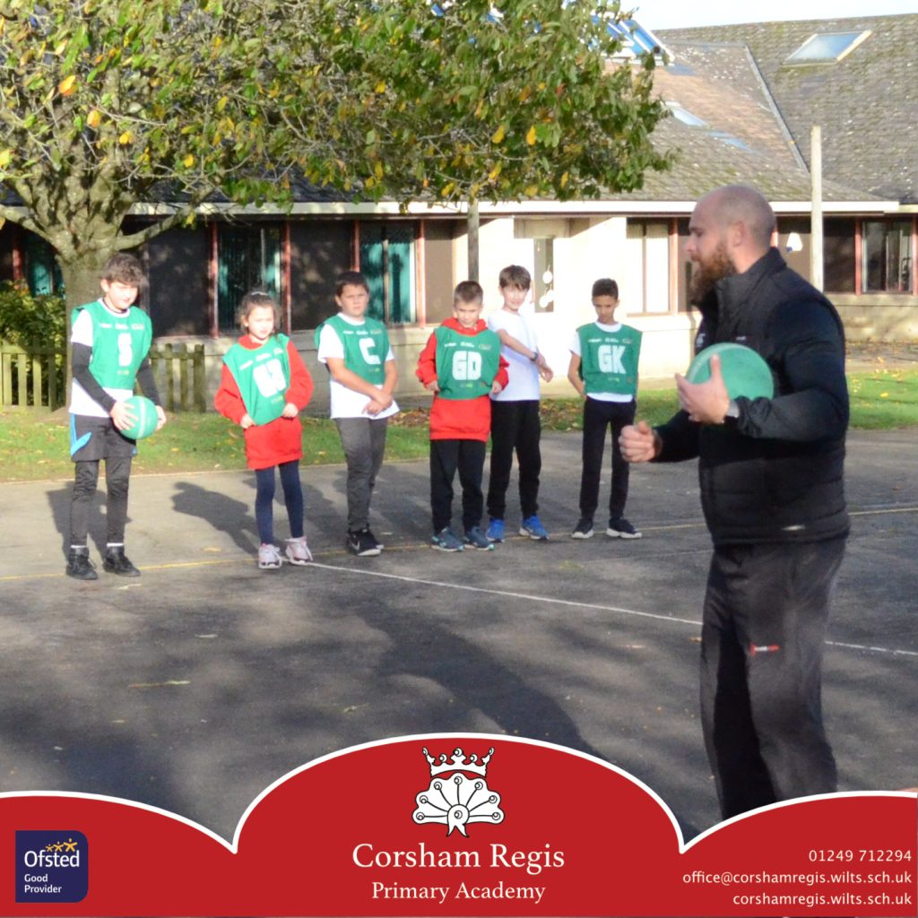
Progression mapping

Slide 4
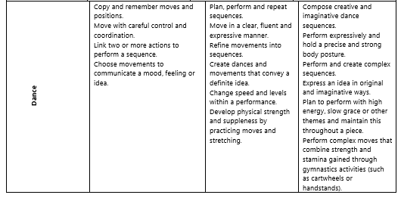
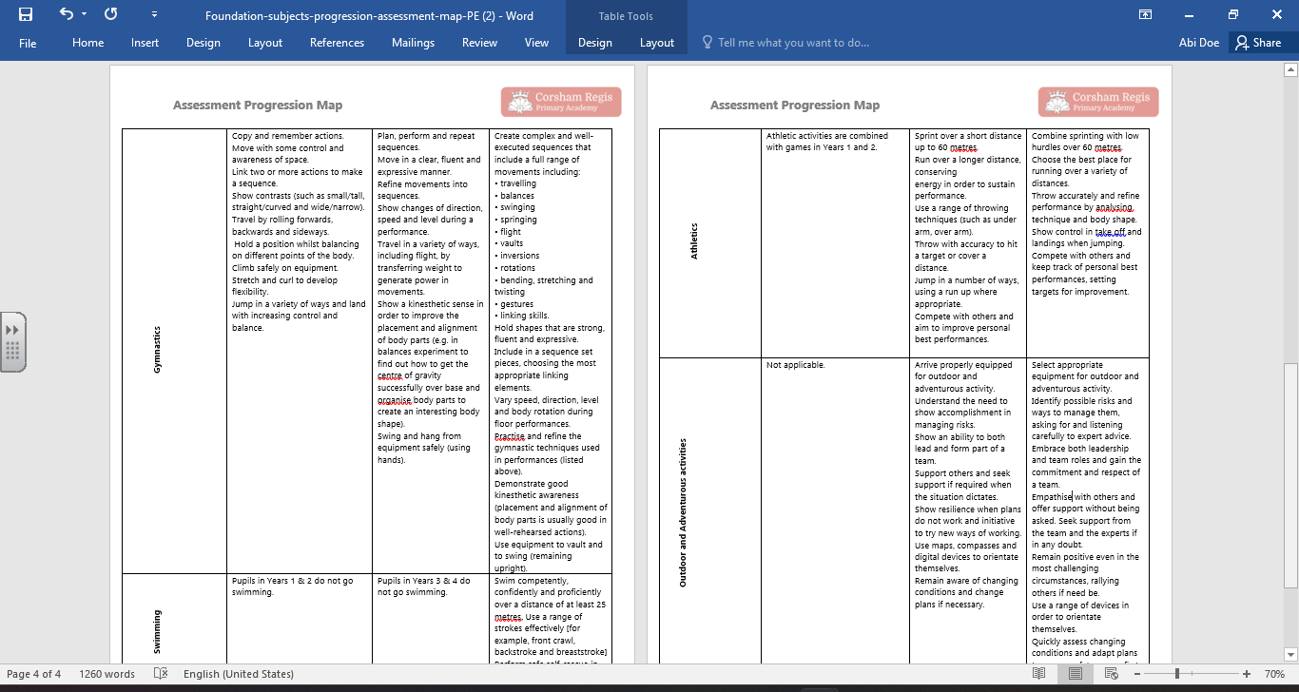
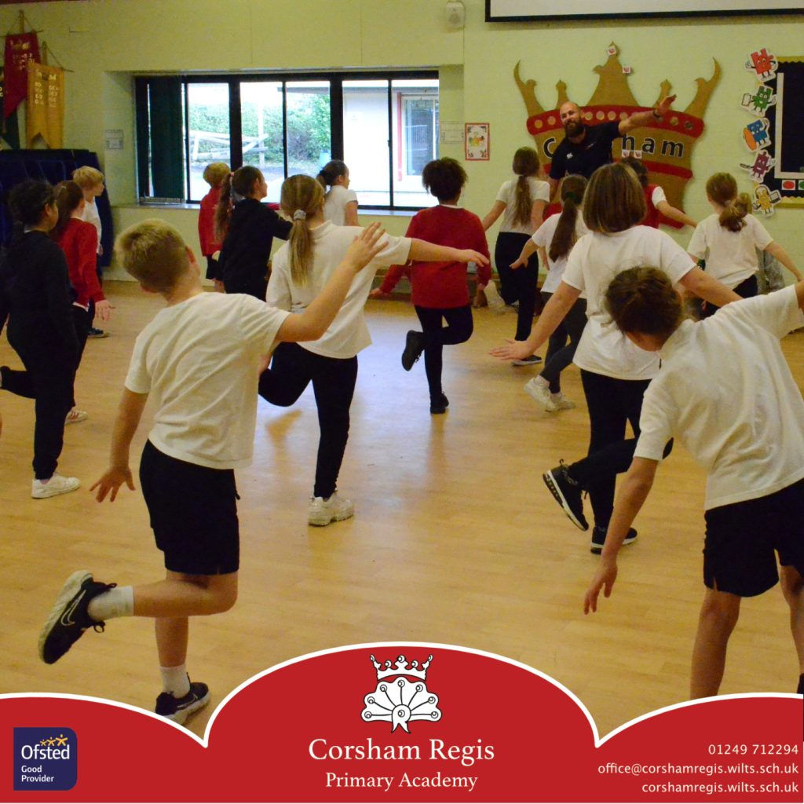
Progression mapping

Slide 5
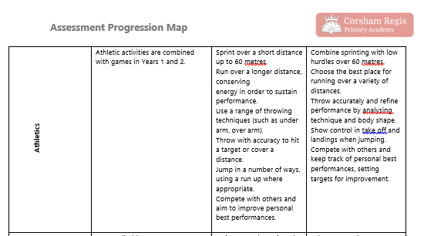
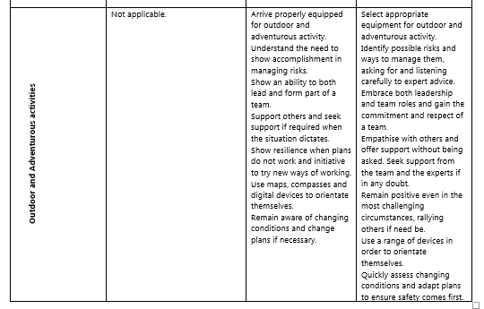

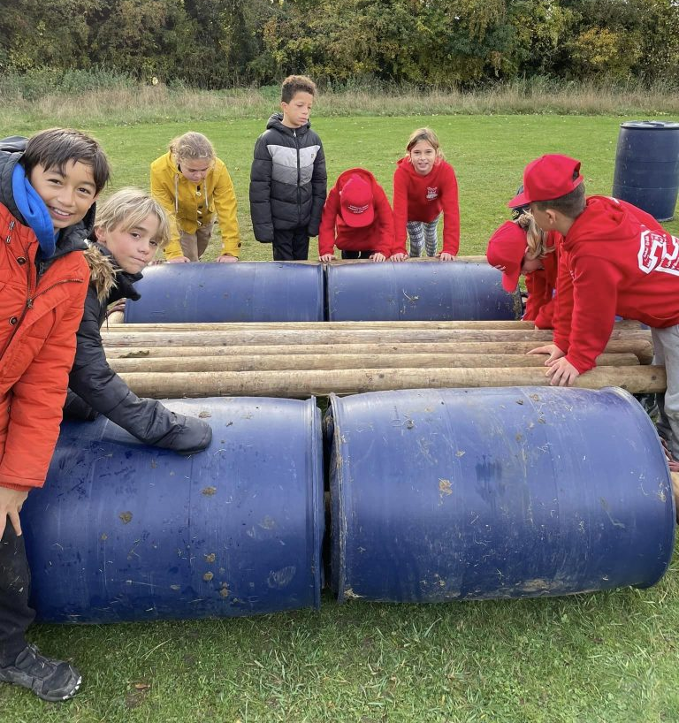
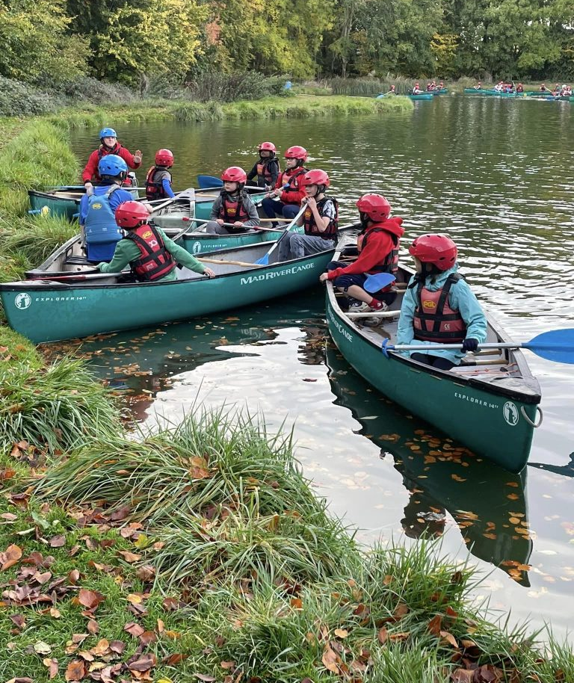

Progression mapping

Slide 6
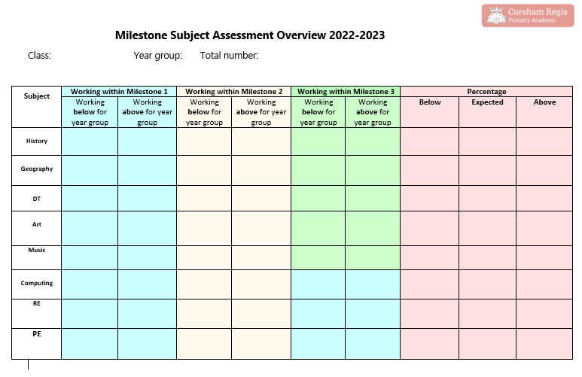
Implementation
How we monitor and assess in PE

Slide 7
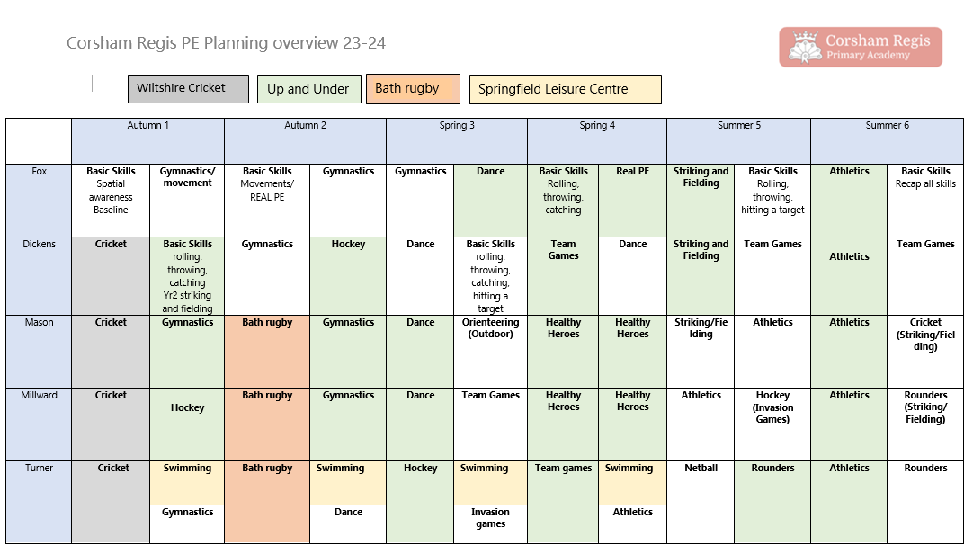
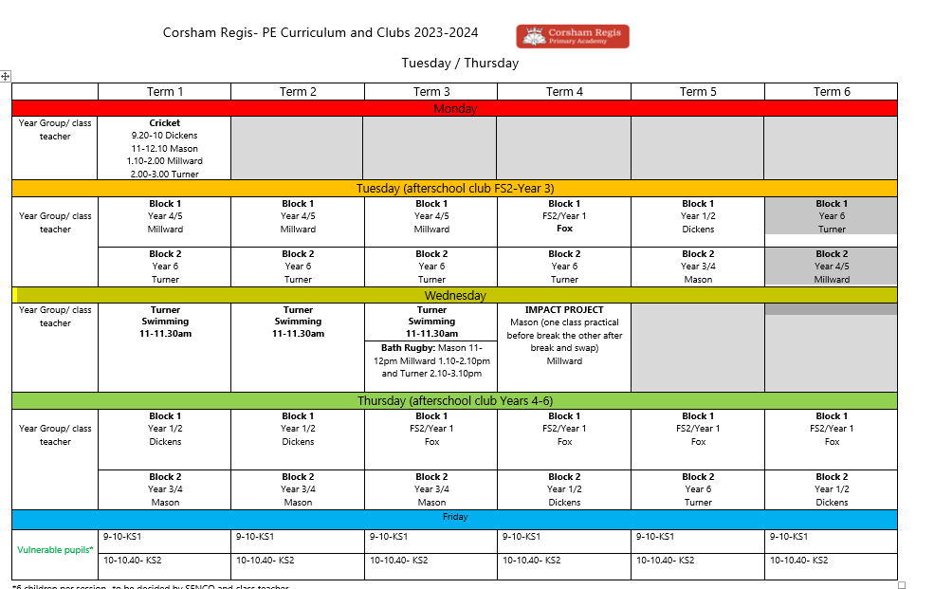
Implementation – planning overview

Slide 8
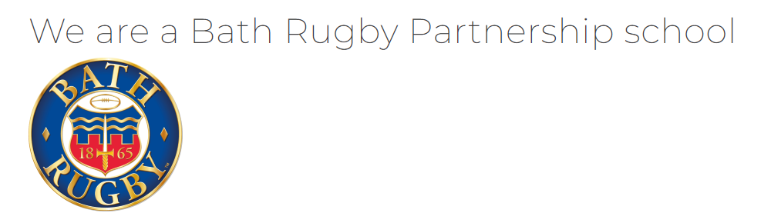









Provision
SPORTS LEADERS

Slide 9
Impact
Our broad PE curriculum provides children with experiences of different sports, in the hope that they will further their interests and strengths outside of school
Our links with external agencies enhance our provision of PE and are used to not only broaden the children’s experiences and develop their skills but staff work alongside these specialists as continuous CPD
Our PGL residential trip in Year 6 enables the children to experience outdoor and adventurous activities such as climbing , abseiling, kayaking, raft building, team games and many more.
Children build their confidence in a range of sports taught by experts.
Some children go on to join clubs outside of school, having been introduced to different sports within school.
Children swim at the Springfield Community Campus in Corsham with the aim for all children being able to swim 25 meters by the time they leave for secondary school.
We encourage all pupils to take part in our weekly Magic Mile Club and approximately 50% of the school attend regularly.
We have sports clubs that are completely free to our pupils: rugby, crockery

Slide 10
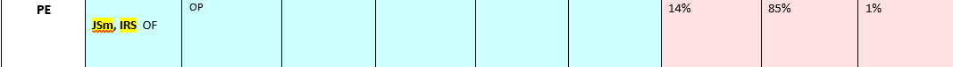
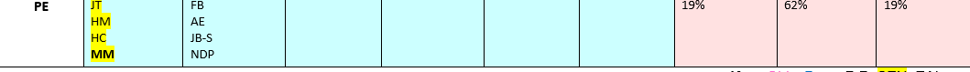
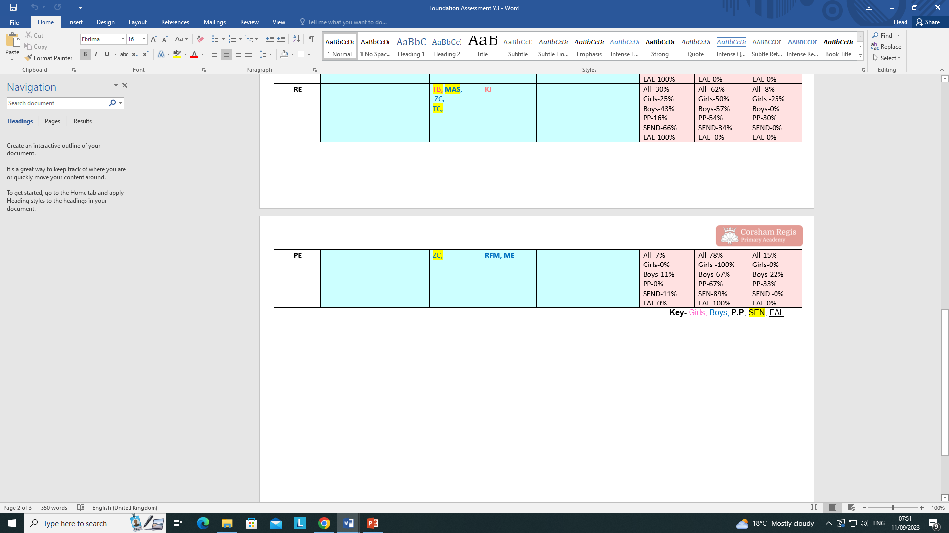
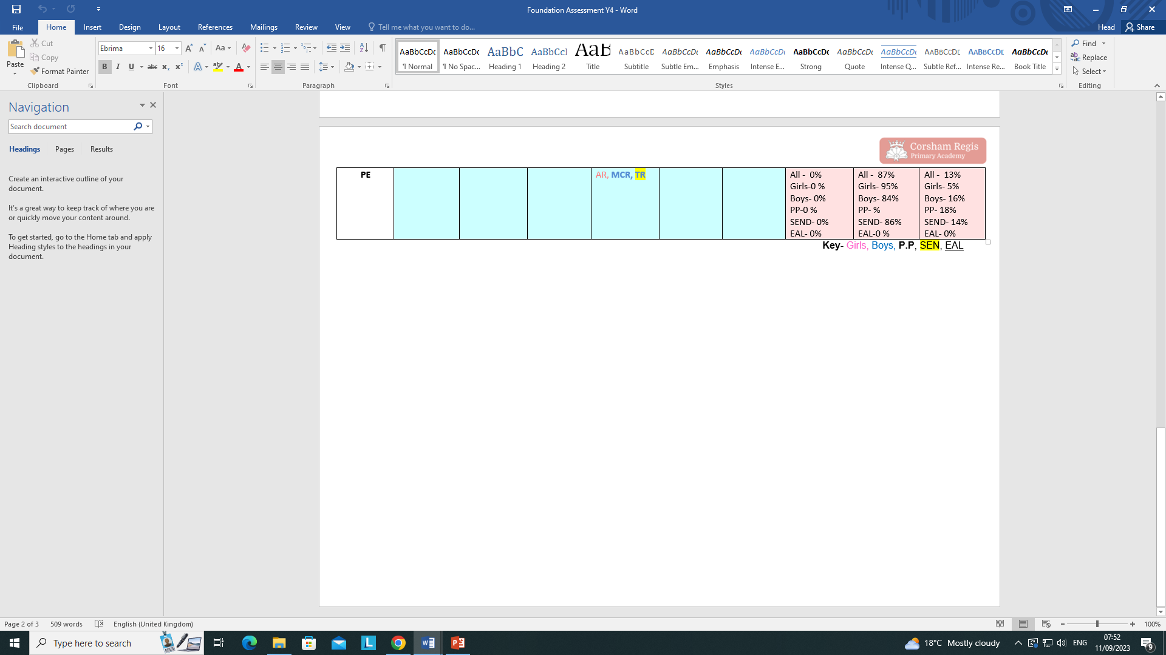
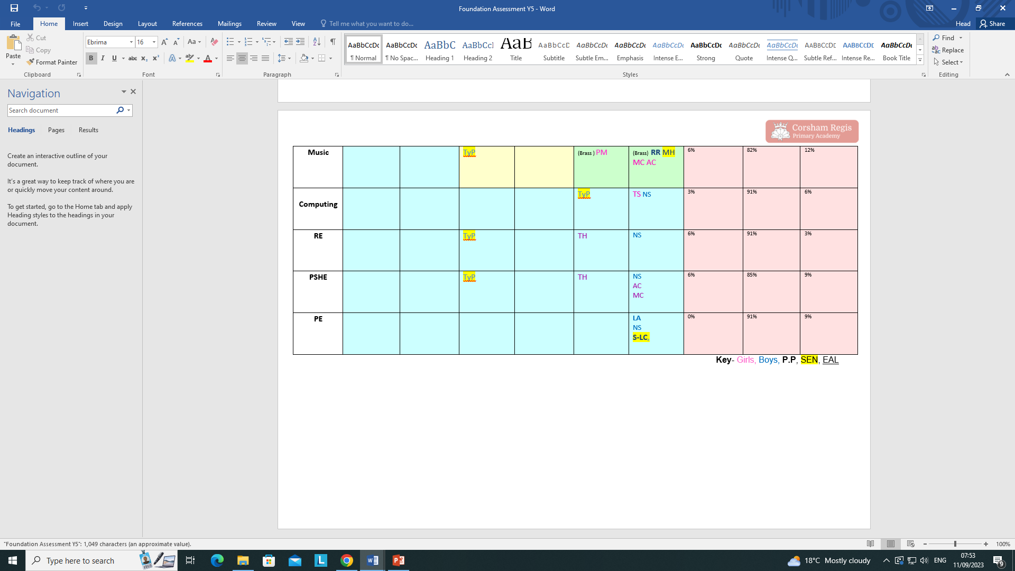
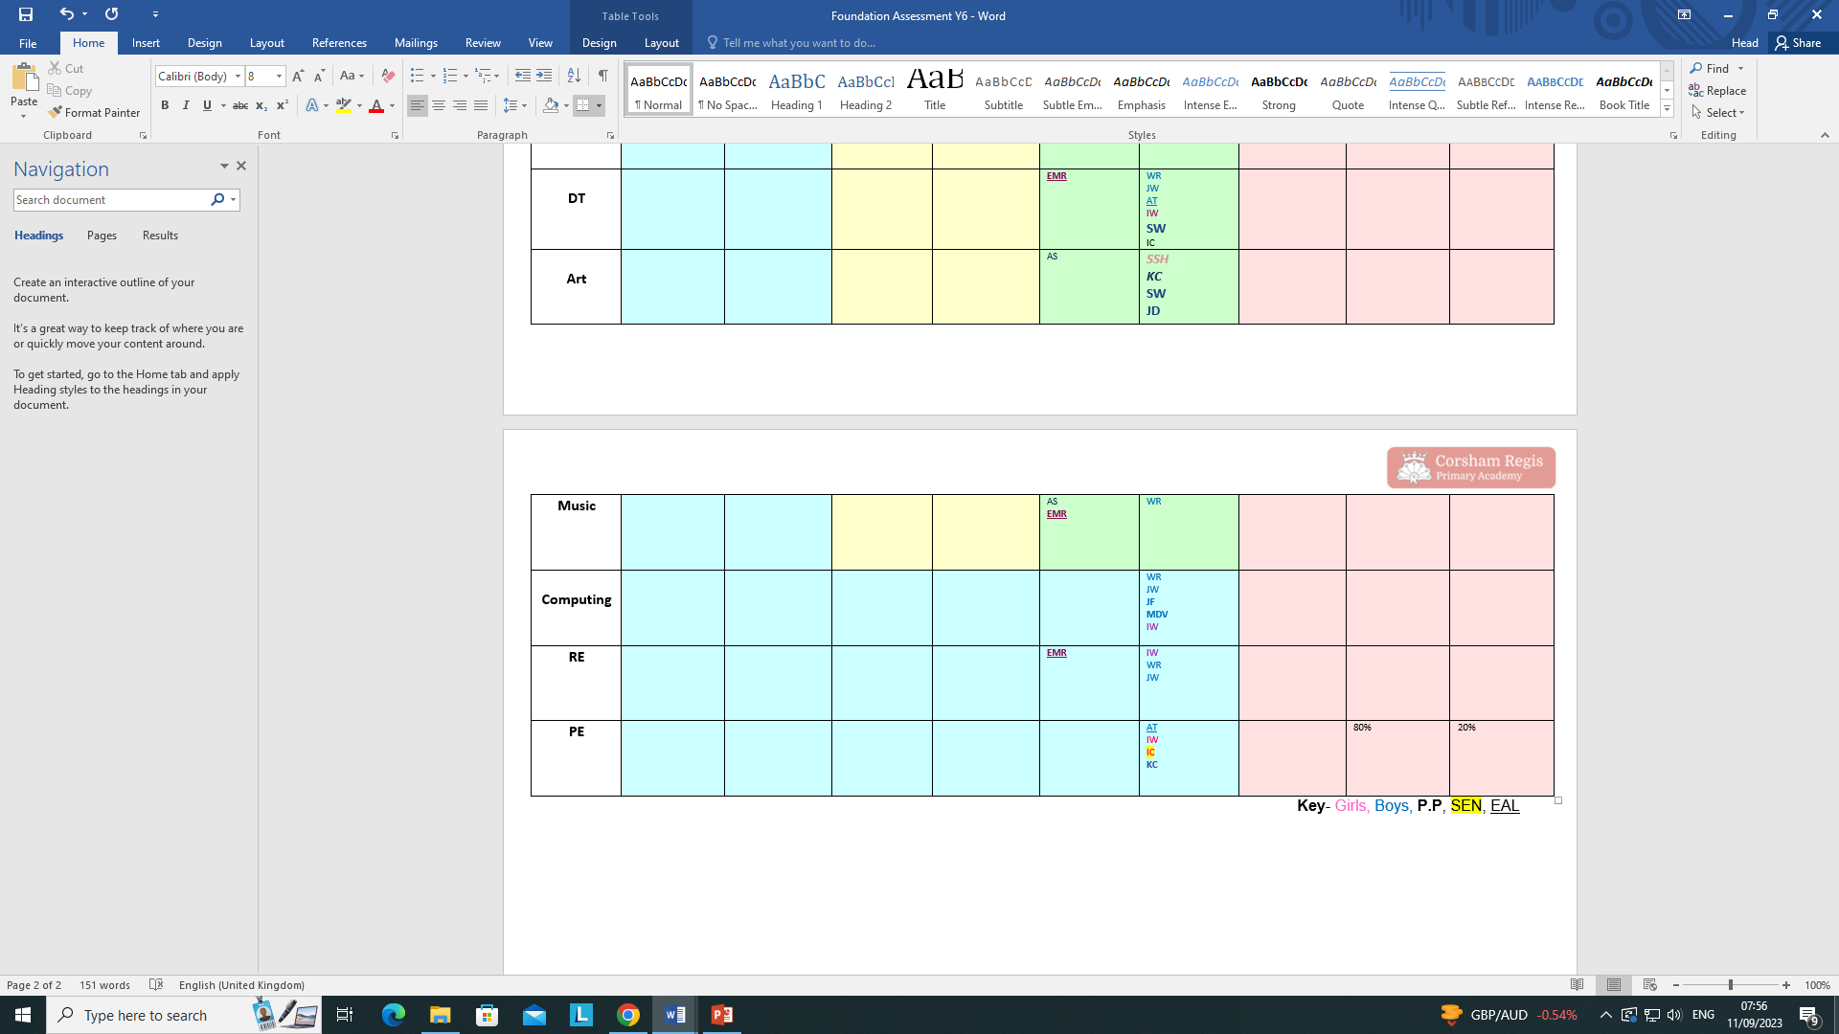
Evidence
Yr 1
WTS EXP GDS
Yr 2
From this data, it is clear that the children build on their skills and develop as they go through the school.
Yr 3
Yr 4
Yr 5
Yr 6

Slide 11
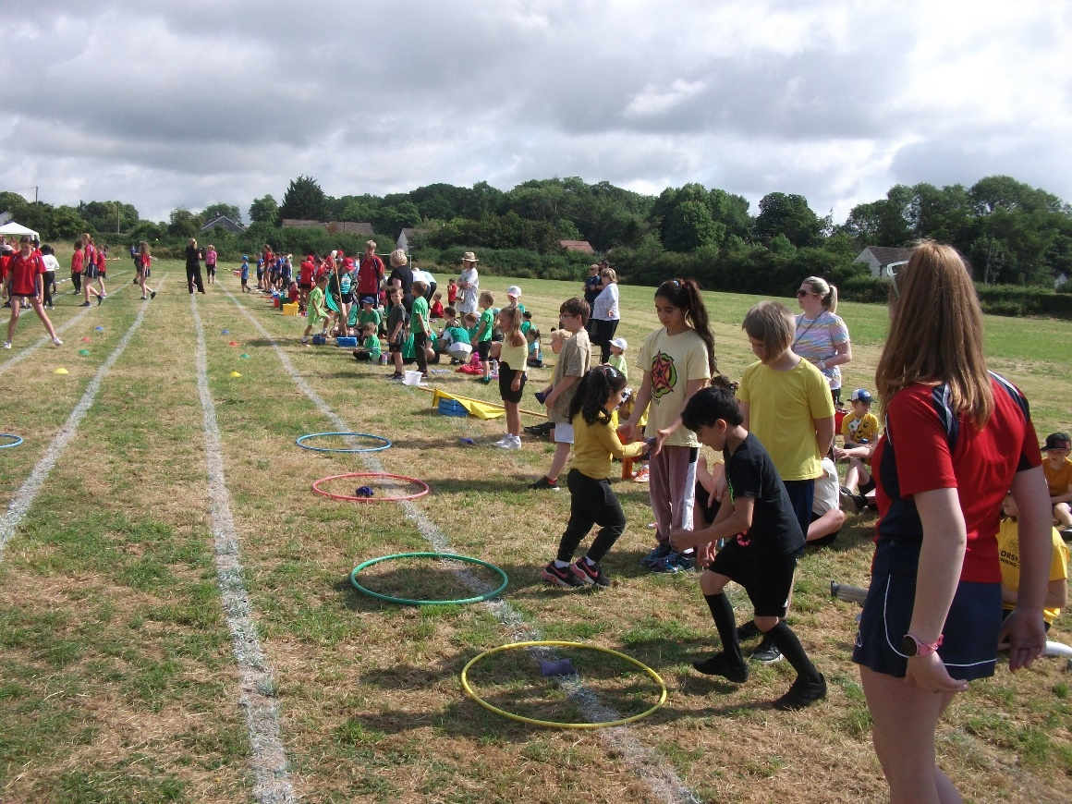
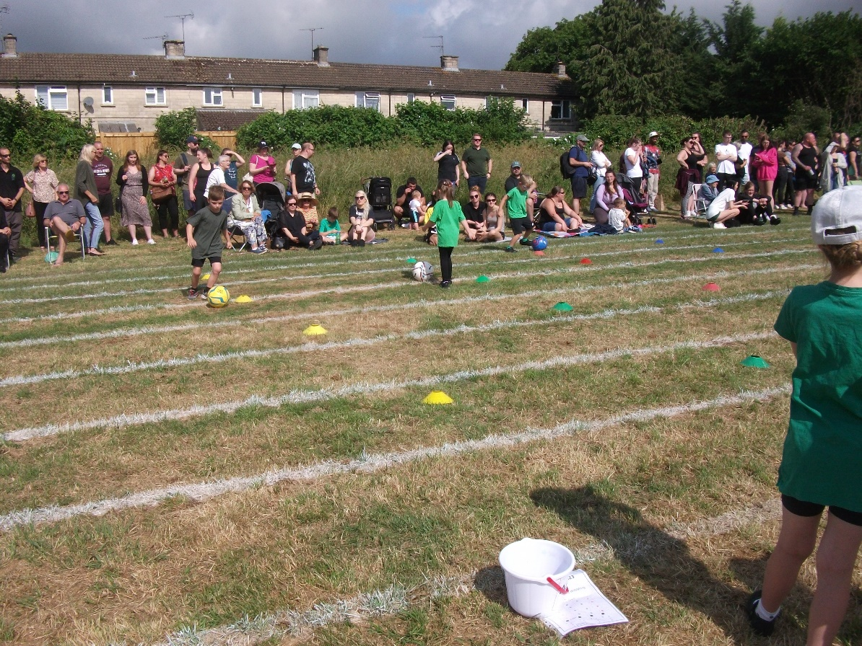
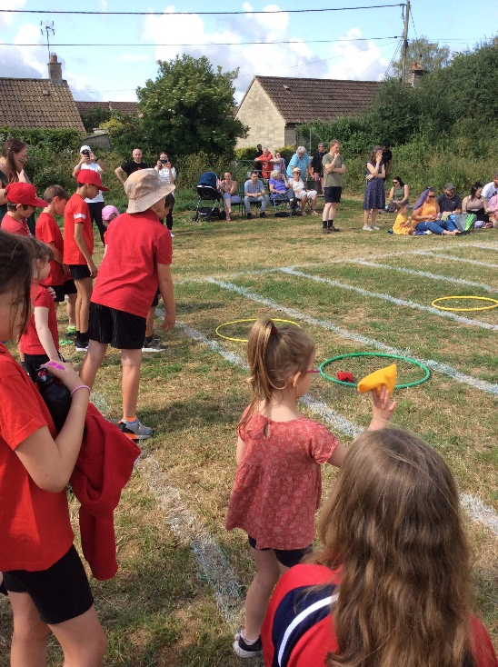
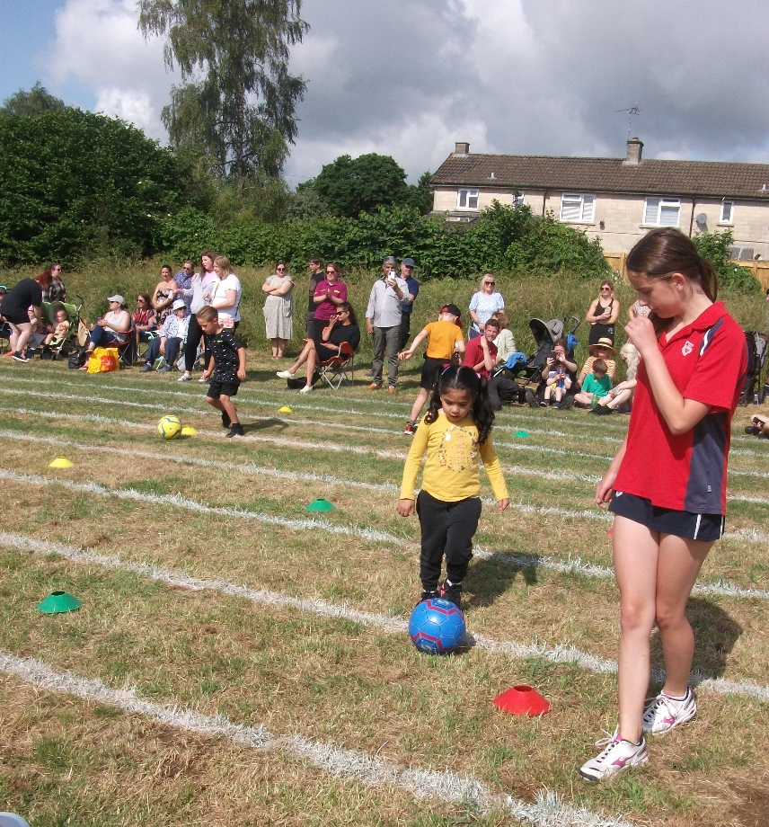
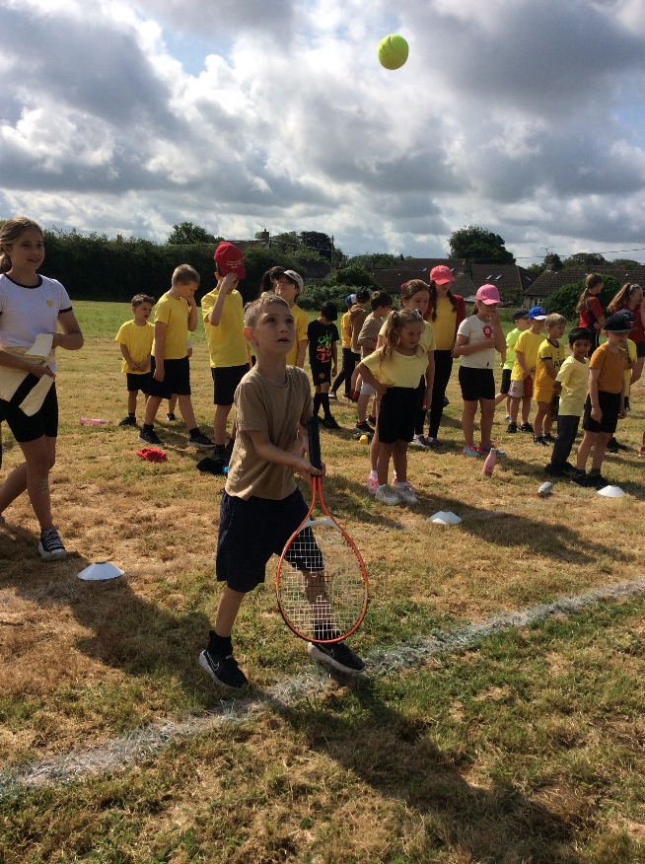
Provision sports day
2023

Slide 12
IMPACT of sports day
All children took part in non-competitive activities to develop throwing, dribbling, team work and bat and ball skills.
Children chose to compete in a range of competitive races.
Parents and carers are always invited to join us for sports day, this helps the children to develop their performance elements of sport and brings the whole school community together
Sports leaders from The Corsham School join us and are aspirational for the children providing excellent role models for them.
Children compete and are awarded points towards their team and with children from across the age ranges represented in each team, the children have to work together and encourage each other, with the older children often supporting the younger ones.

Slide 13

Children’s voice
Bath Rugby come and we learn new skills.
Year 3
I like that we get to play dodgeball with Mr Peters.
Year 2
We get to play different games.
Year 1
Up and Under sports clubs are great.
Year 3
PE keeps me fit and healthy.
Year 6
We get to learn new skills.
Year 3
II like PE because it’s
A lot of fun.
Year 1
It allows us to try a good variety of sports so we know what we could do outside of school. Year 6
PE is healthy!
Year 5
It’s just the best subject!
Year 6
Cluster competitions give us more competitive challenges. Year 6
Swimming is great and improves your confidence. Year 6

Slide 14
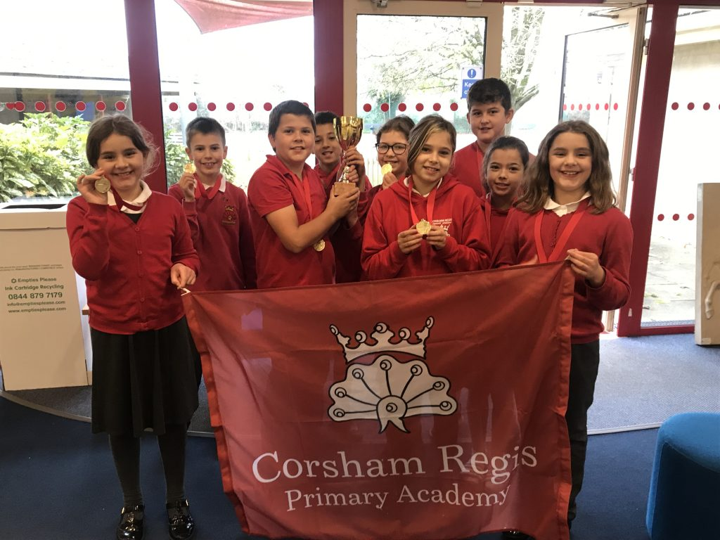
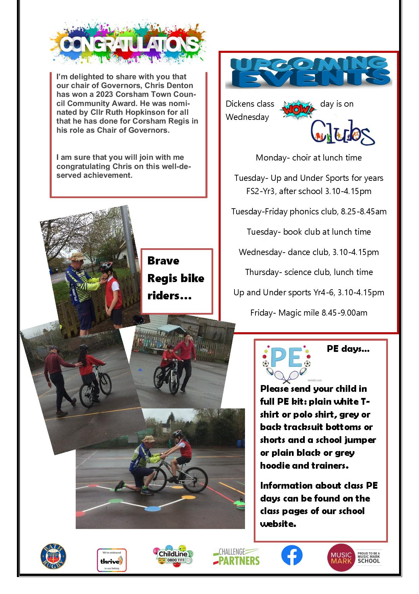
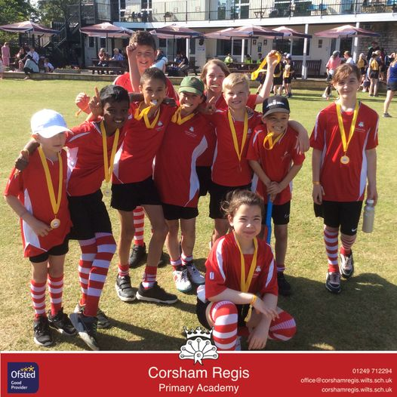
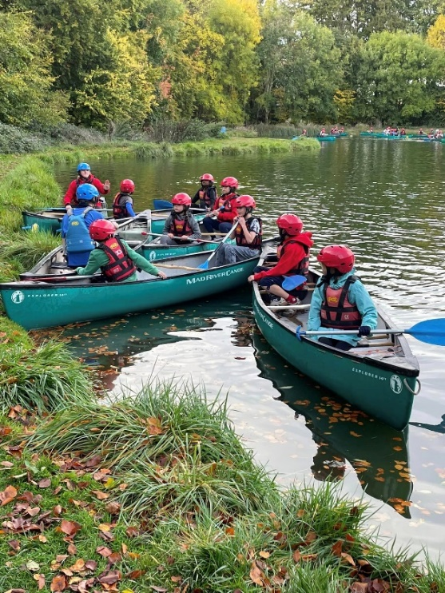
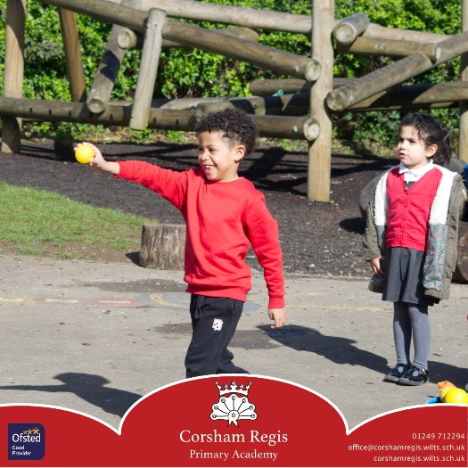
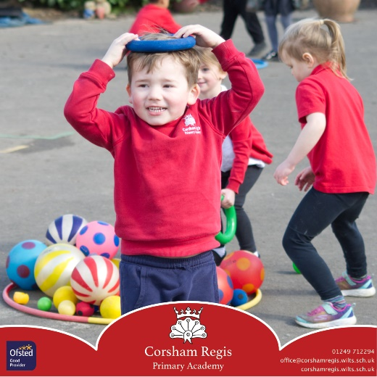
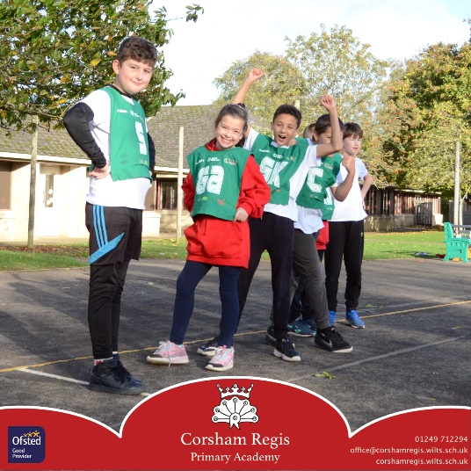
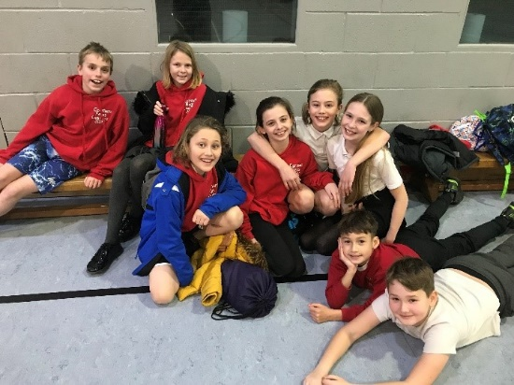
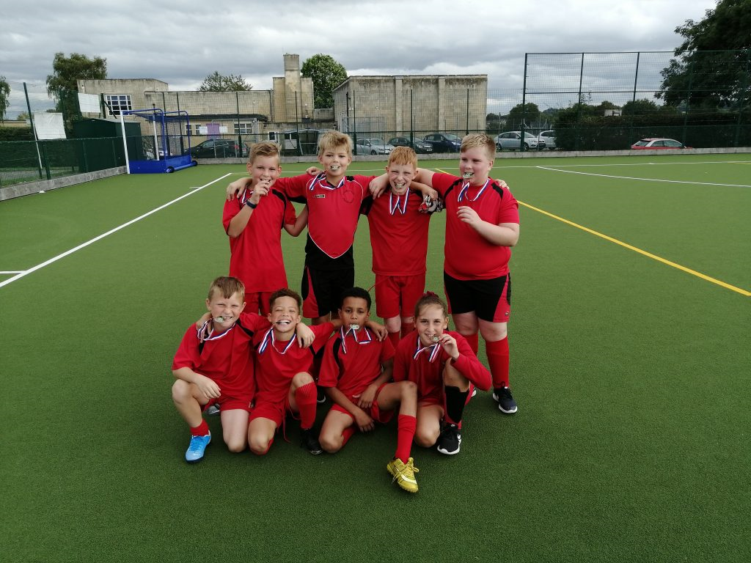
Photos/ regis magic moments
Year 5/6 cricket winners
2023!

Slide 15
Final reflection/next steps
Continue to use Up and Under Ltd for mentoring, coaching and extra-curricular club provision
Explore continuing with Bath Ruby Partnership to further enhance this provision
Consider other girls only sports clubs to further promote girls in sport.
Continue to provide a range of sports clubs and promote participation.
To continue our involvement with Wiltshire cricket to promote cricket in school.
To consider how more children could benefit from the opportunity of attending a live Rugby match.
Continue to use Up and Under Ltd for mentoring, coaching and extra-curricular club provision
Continue to elect a sportsperson of the year

