Slide 1
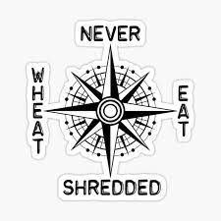
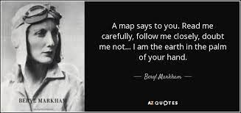
Knowledge Organiser for: Geography Term: Summer 5 Year group: 5/6 Turner Class
Skills and Knowledge
 | Question | Answer
1 | How would you describe each of the four elements of map reading? | Use the eight points of a compass, four-figure grid references, symbols and a key.
2 | How can you communicate your knowledge of the UK and wider world through map work? | By identifying land use, climate zones, population densities, height of land.
3 | What do you need to know to make your own map of a location? | Identifying patterns (such as: land use, climate zones, population densities, height of land).
4 | What do you need to identify on your map? | land use, climate zones, population densities, height of land
5 | How effective are different types of maps at representing a location? | There are many kinds of maps; static, two-dimensional, three-dimensional, dynamic and even interactive. Most static maps are drawn on a flat surface but are sometimes displayed on a round surface is called a globe
6 | Why might some map types be more appropriate to use than others? | There are many kinds of maps; static, two-dimensional, three-dimensional, dynamic and even interactive. Most static maps are drawn on a flat surface but are sometimes displayed on a round surface is called a globe
7 | What is the importance of storing and handling ingredients correctly? | food deteriorates over time; micro-organisms can be carried by food, people, dirty equipment, animals and pests; micro-organisms needs certain conditions to grow – this is why food needs to be properly stored; food poisoning is caused by some of these micro-organisms (food poisoning bacteria); the risk of poisoning can be minimised through simple food safety and hygiene procedures; there are beneficial uses of some micro-organisms, e.g. in bread and yogurt making.
8 | How do you measure ingredients accurately and calculate ratios in order to scale a recipe up or down? | Measuring spoons, liquid measuring cups, and dry measuring cups.
9 | Why do you need to know a range of cooking and baking techniques? | To be independent, safe and responsible.
10 | What would you need to include in the creation of your own recipes? | A surprise!

