Slide 1
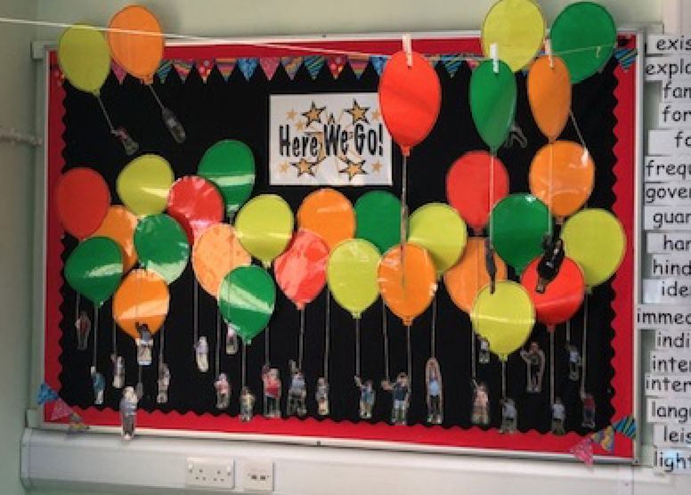
Meet the Teacher
Crystal Class

Slide 2
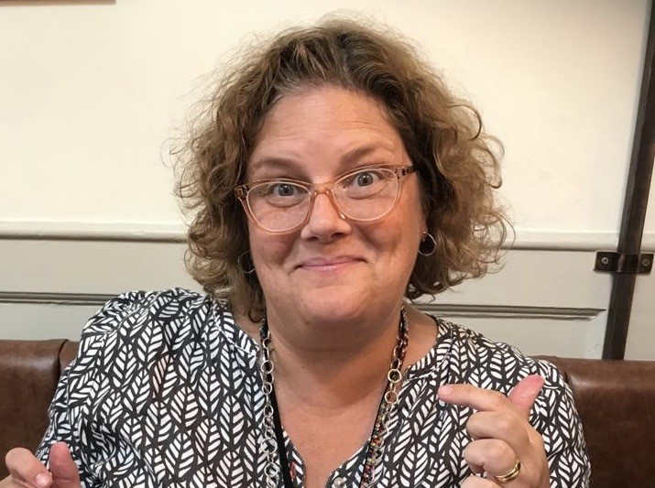
I am in Crystal Class all week.
I will teach Crystal Class all day Monday, Tuesday, Wednesday and Thursday afternoon.
I will teach Crystal Class on Thursday morning and Friday all day.

Slide 3
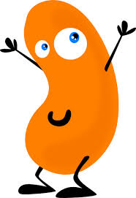
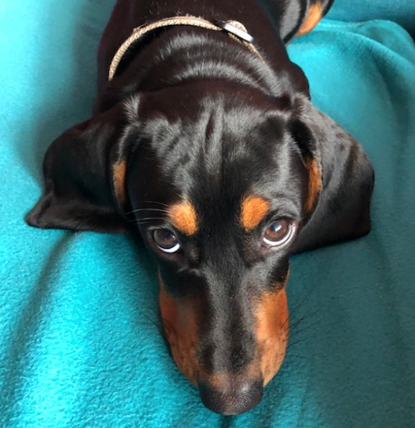
Teacher: Abigail Doe
Likes: Spending time with my two daughters (Poppy and Honey), my husband Peter and my puppy Norman.
Dislikes: Baked beans and putting the bins out.
Acting Key Stage 2 Leader and Curriculum
Team Leader for Reading
Teaching for: I have been teaching for 22 years. Always in Key Stage 2. I love working within the community I live in.
Teaching Assistants: Is the wonderful
Mrs Maria Smith.

Slide 4
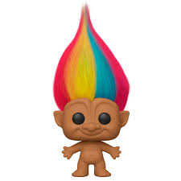
Teacher: Sarah Hodges
Likes: Yoga, going out for dinner, long walks and picnics.
Dislikes: unkindness and boring hair!
Teaching for: 30 years as a Nursery teacher, SEN TA and HLTA
Teaching Assistants: Mrs Maria Smith

Slide 5
Teacher: Mrs Smith
Likes: Spending time with my family, reading, going to the beach and eating chocolate.
Dislikes: Spiders, rudeness and dishonesty.
Teaching Assistant for: 10 years - Mostly in KS1 and FS2 and a little in KS2. I have worked as a class TA and as a 1:1 TA. This is my second year in Year 5.
Teacher: Mrs Abigail Doe

Slide 6
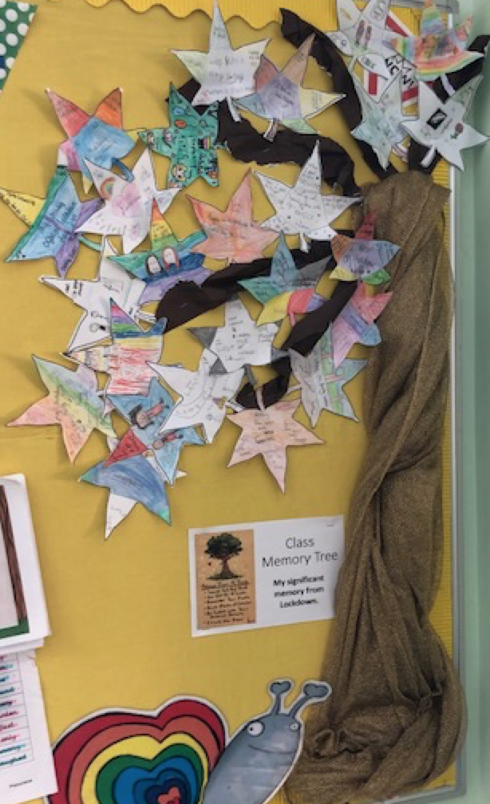
Some of our Wellbeing learning so far!

Slide 7
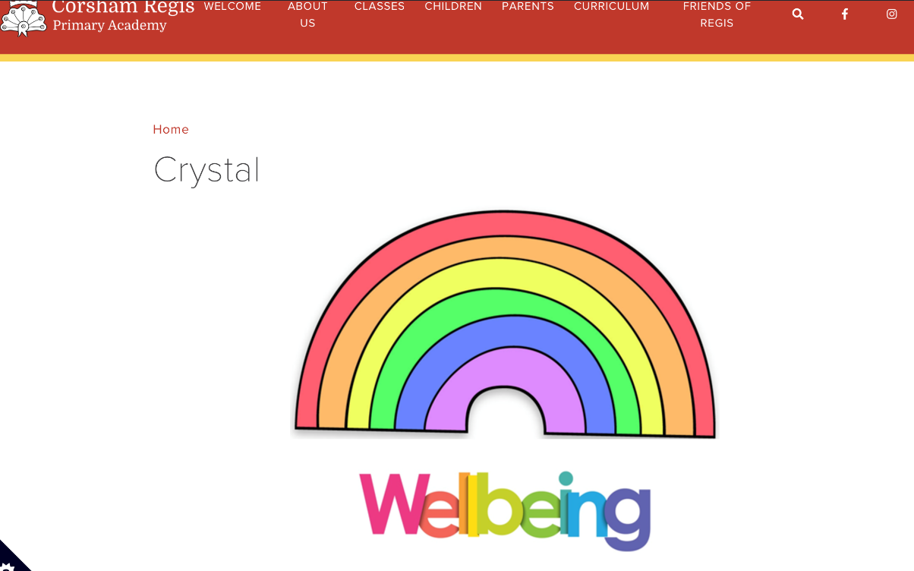
Website link
http://www.corshamregis.wilts.sch.uk/crystal/

Slide 8
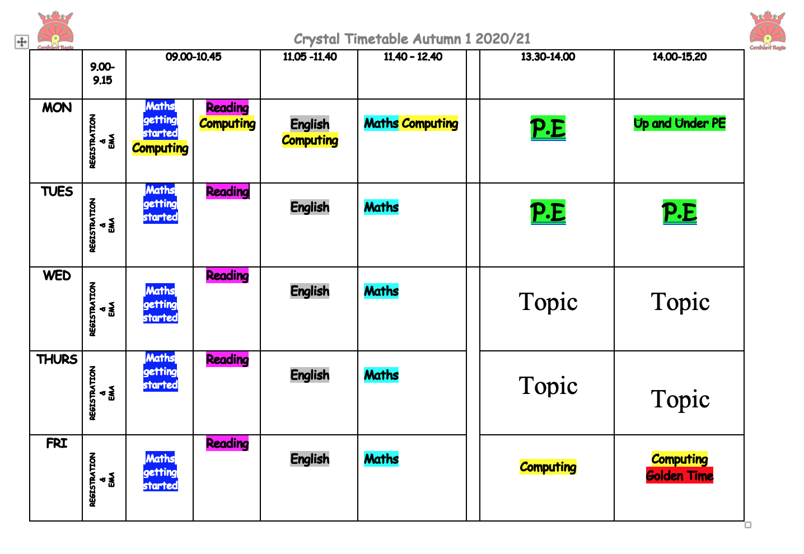
Timetable

Slide 9
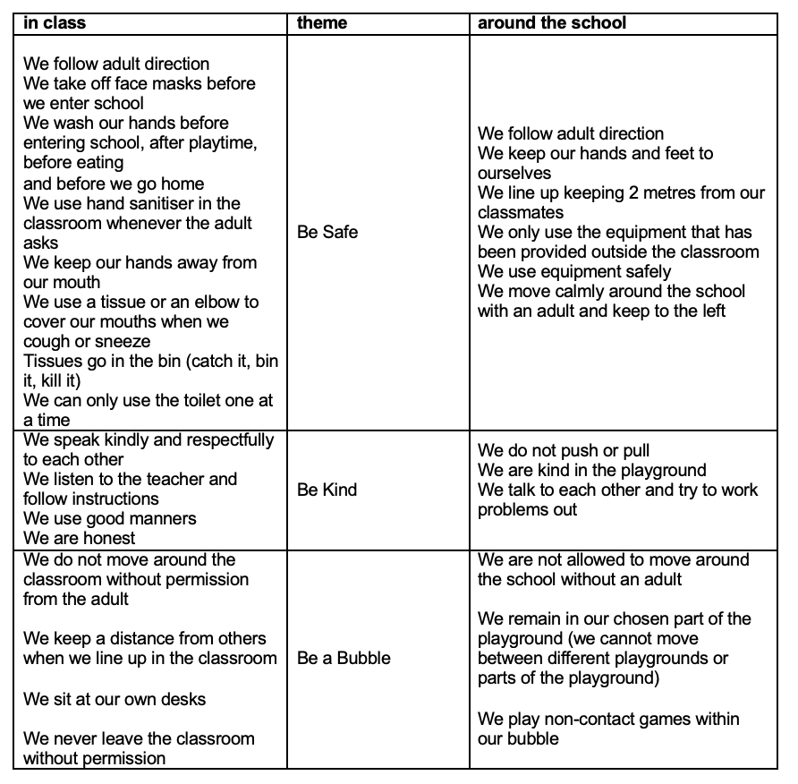
Behaviour

Slide 10
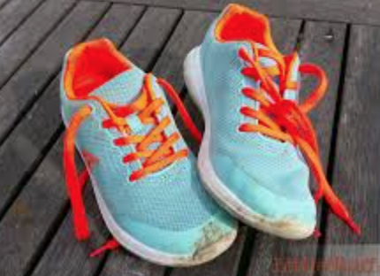
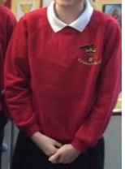
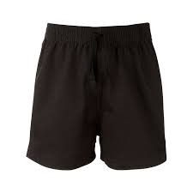
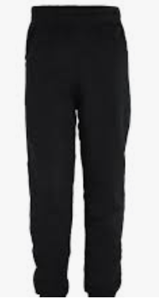
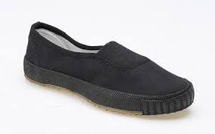
PE
PE Kits need to be worn to school on Monday and Tuesday.

Slide 11
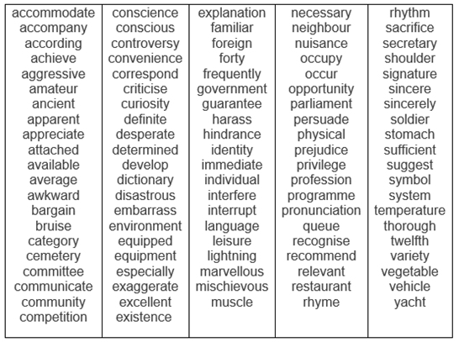
Spellings
These are the statutory words for Year 5/6.
We will be asking children to learn spellings at home. We ask that you spend time supporting your child with the words that they find tricky.
They will be tested every week via dictation.

Slide 12
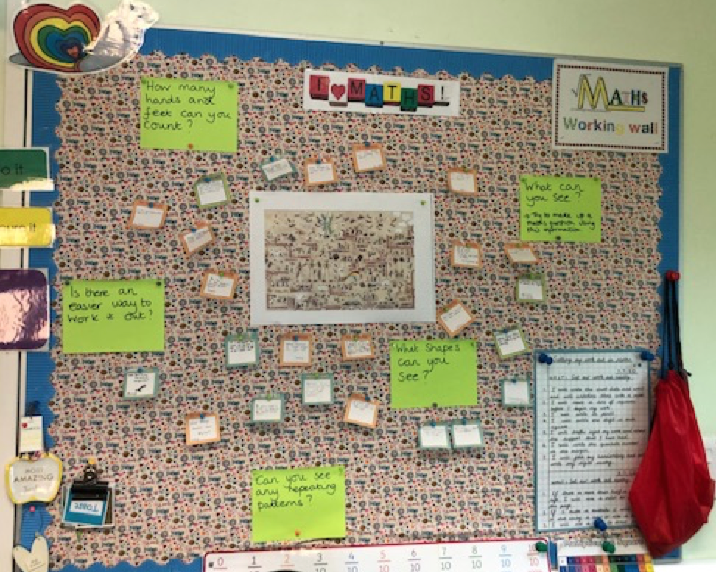
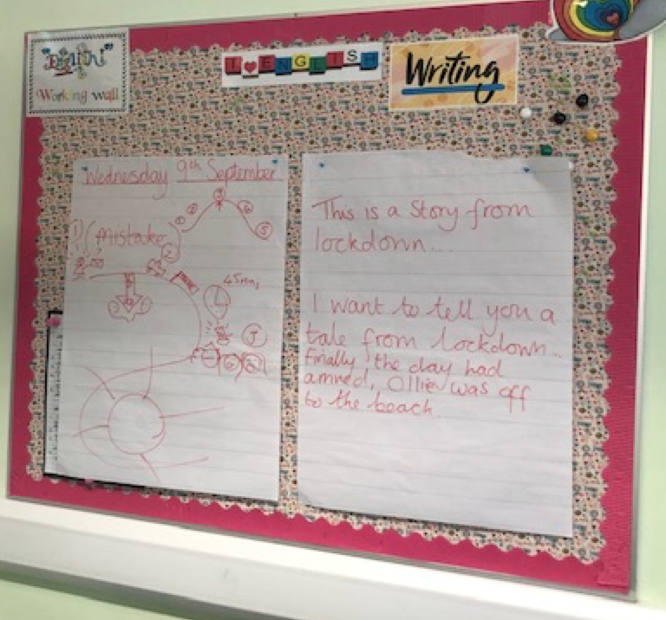
Our Working Walls

Slide 13
We will work our way through the Key Objectives in English and Maths by using the results from our PiXL assessments.

Slide 14
English in Year 5
Writing Key Objectives
I am beginning to plan the structure of my writing by thinking about the audience for my text and the purpose of the writing.
I review my work to add description to develop settings and characters.
I use headings and bullet points to structure my writing.
I use the correct tense throughout a piece of writing.
I can read through my work to correct some spelling and punctuation mistakes.
I use modal verbs (such as can/could, may/might, must, will/would, and shall/should) to explain how something might be possible.
I can convert nouns or adjectives into verbs using suffixes [for example, -ate; -ise; -ify].
I can make the structure in my paragraph more interesting by using word structures such as then, after that, this, firstly.
I use commas to structure my sentences and clarify the meaning of a text.

Slide 15
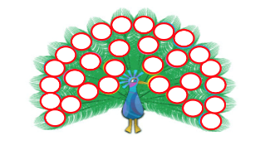
English in Year 5
Reading Key Objectives
I use some of the words and word parts that understand already to think about what new words mean and sound like.
I am becoming familiar with a range of books.
I check my understanding of a text through discussion and exploring the meaning of words.
I am able to make simple summaries of a given number of paragraphs I have read.
I can find and make notes on information from non-fiction.
I am beginning to participate in discussions about books I have read by listening to others' ideas.
I am able to explain my views.

Slide 16
Mathematics in Year 5
Key Objectives in Maths
I can read, write, order and compare numbers to at least 1 000 000 and know the value of each digit.
I can use negative numbers in my work and can count backwards and forwards to and from negative numbers.
I can add and subtract whole numbers with more than 4 digits using written methods such as column addition and subtraction.
I can add and subtract larger numbers in my head.
I can identify multiples and factors, including finding all factor pairs of a number, and common factors of two numbers.
I can solve multiplication and division problems using my knowledge of factors and multiples, squares and cubes.
I can solve problems including scaling by simple fractions and problems involving simple rates.
I can compare and order fractions whose denominators are all multiples of the same number.
I can read and write decimal numbers as fractions [for example, 0.71 = 71/100].
I can read, write, order and compare numbers with up to three decimal places.
I work on problems which require knowing percentage and decimal equivalents of 1/2, 1/4, 1/5, 2/5, 4/5 and those fractions with a denominator of a multiple of 10 or 25.
I can convert between different units of metric measure (for example, kilometre and metre; centimetre and metre; centimetre and millimetre; gram and kilogram; litre and millilitre).
I can calculate the perimeter of multi-shape shapes in centimetres and metres.
I can calculate the area of rectangles in square centimetres (cm2) and square metres (m2) and estimate the area of irregular shapes.
I can draw a given angle (such as 47°), and then measure them in degrees (°).
I know regular shapes have equal sides and angles and irregular shapes do not have equal sides and angles.
I can find the information I need from a timetable or large table of data.

Slide 17
Homework
Practice quick-fire times table questions and mental maths.
Practice Spellings.
Read with an adult.

Slide 18
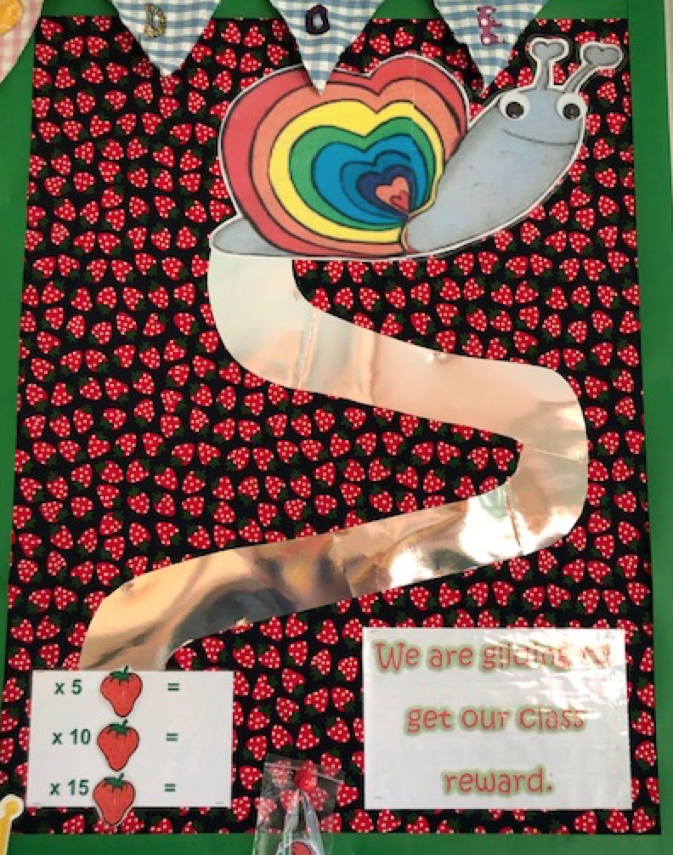
The class voted on their class reward.
Class Reward
X 5 = Movie, popcorn and PJ day.
X10 = Tech Day
X15 = Picnic at the park

Slide 19
